Slide 1
Pathological features of eosinophilic oesophagitis

Slide 2
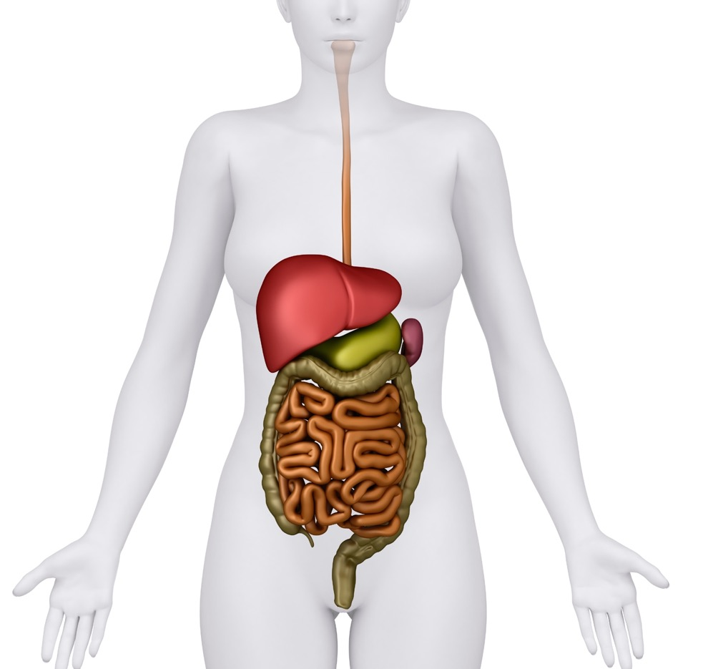
Eosinophil numbers typically increase as you go down the gut¹
Upper normal limits for eosinophil numbers within the GI tract¹
Eosinophils are typically present throughout the GI tract since it is continuously exposed to foods, environmental allergens, toxins, and pathogens²
In healthy individuals, however, the oesophagus is unique in that eosinophils are generally absent²
oesophagus <15/hpf
stomach <30/hpf
ileum <50/hpf
colon <50-100/hpf
Collins MH. Gastroenterol Clin North Am 2014; 43(2): 257-68.
Carr S, Watson W. Allergy Asthma Clin Immunol 2011; 7 (Suppl.1): S8.
hpf: high-power field
GI: gastrointestinal

Slide 3
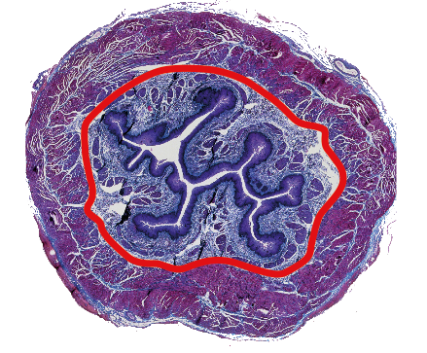
Eosinophilic oesophagitis
EoE is a progressive inflammatory disorder in which eosinophils infiltrate the oesophageal epithelium¹
Chronic eosinophilic inflammation leads to changes in oesophageal structure²
While symptoms such
as feeling like food is moving slowly/sticking
in the chest after swallowing, or food bolus obstruction, point to EoE, it takes histology to confirm the diagnosis³
Fibrosis laid down
Chronic inflammation
Tissue
changes
Collagen
deposition
Fibrous
remodeling
Formation of rings, strictures,
and narrow calibre oesophagus
1. Oliva S, Dellon ES. Dig Liver Dis 2021; 53(11): 1476-8.
2. Lucendo AJ, Molina-Infante J. Expert Rev Clin Immunol 2022; 18(8): 859-72.
3. Attwood SE. Br J Hosp Med (Lond) 2019; 80(3): 132-8.
EoE: eosinophilic oesophagitis

Slide 4
Diagnosing eosinophilic oesophagitis
Standard oesophageal biopsies that sample the epithelium are intrinsic to the diagnosis of EoE¹
Historically, peak eosinophil counts per high-power field have been used to define the cut-off for diagnosis²
    however, hpf area may vary significantly between different microscopes
  With most laboratories now moving to digital optical microscopy, the definition of EoE was expanded in the latest BSG guidelines³
1. Hirano I. J Gastroenterol 2020; 55(3): 249-60.
2. Younes M et al. Gastroenterology 2022; 163(6): 1719-20.
3. Dhar A et al. Gut 2022; 71(8): 1459-87.
BSG: British Society of Gastroenterology
EoE: eosinophilic oesophagitis
eos: eosinophils
hpf: high-power field

Slide 5
At least 6 biopsy samples should be taken to diagnose EoE^{1,2}
EoE is a patchy disease with considerable variability in the distribution of mucosal eosinophilic infiltration²
    within the same patient, it is common to see eosinophil counts within both the normal and abnormal range in different segments of the oesophagus
Ability to correctly identify those with EoE³
It is recommended to take biopsy samples from multiple levels along
the length of the oesophagus, ideally targeting areas of visible inflammation, if present²
    one study found 20% of patients would have been missed if only proximal biopsy samples were taken
100
80
60
40
20
0
~100%
Sensitivity (%)
55%
Single biopsy
Six biopsies
Dhar A et al. Gut 2022; 71(8): 1459-87.
Aceves SS et al. Gastrointest Endosc 2022; 96(4): 576-92.
Beg S et al. Gut 2017; 66(11): 1886-99.
EoE: eosinophilic oesophagitis

Slide 6
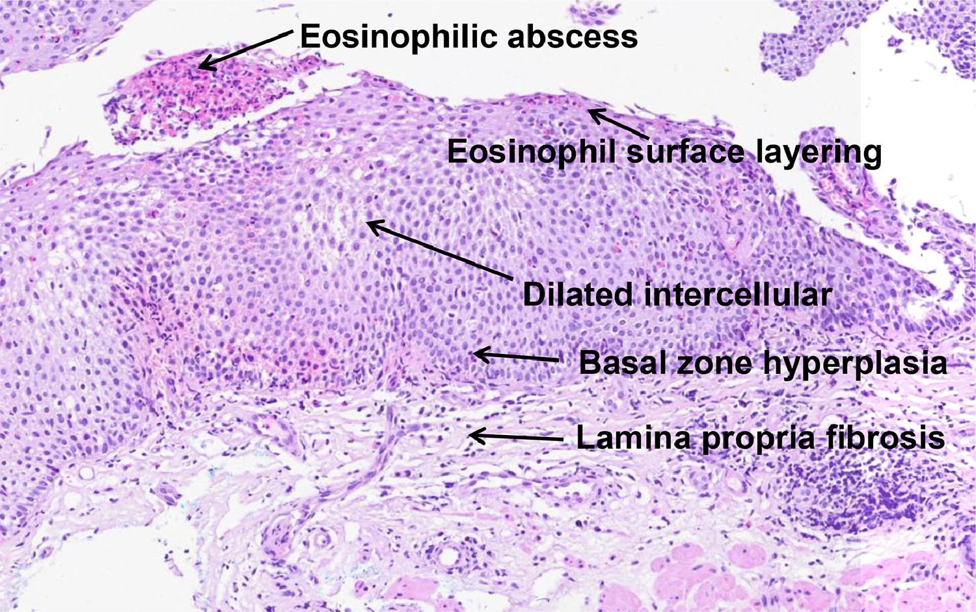
Evaluating other pathologic features in EoE: the EoE histologic scoring system (EoEHSS)
Histological features observed in EoE²
The validated EoEHSS evaluates
7 pathologic features in addition to peak eosinophil count for both severity and extent of pathology using a 4-point scale (0=normal, 3=most severe or extensive):¹
Eosinophilic abscess
Eosinophilic surface layering
    BZH: basal zone hyperplasia
    EA: eosinophil abscess
    ESL: eosinophil surface layering
    DIS: dilated intercellular spaces
    SEA: surface epithelial alteration
    DEC: dyskeratotic epithelial cells
    LPF: lamina propria fibrosis
Dilated intercellular spaces
Basal zone hyperplasia
Lamina propria fibrosis
1. Collins MH et al. Dis Esophagus 2017; 30(3): 1-8.
2. Vieira MC et al. J Pediatr (Rio J) 2022; 98(1): 26-32.
EoE: eosinophilic oesophagitis
EoEHSS: EoE histologic scoring system

Slide 7
Distinguishing GORD from EoE
While it is important to distinguish between EoE and GORD, this can be challenging as many of their clinical and histological features overlap¹⁻³
Factors | EoE | GORD
Dominant symptom | Dysphagia | Heartburn Regurgitation
Food impaction | Common | Uncommon
Gender | Male predominance | Male = Female
Age | Children, young adults | Middle age
Endoscopic findings | Oedema, rings, exudates furrows, strictures, crepe-paper oesophagus, narrow calibre oesophagus | Erosions, ulcers, Barrett metaplasia, hiatal hernia, strictures
 | Normal findings on endoscopy – minority | Normal findings on endoscopy – majority
Histology | ≥15 eos/hpf | <7 eos/hpf
Distribution of eosinophilia | Diffuse more suggestive of EoE | Distal more suggestive of GORD
Additional histological features (BZH, EA, ESL, DIS, SEA, DEC, LPF) | More commonly found | Less commonly found
Positive intercellular IgG4 stain | ~75% | <10%
Wong S et al. JGH Open 2020; 4(5): 851-5.
Kia L, Hirano K. Nat Rev Gastroenterol Hepatol 2015; 12(7): 379-86.
Wong S et al. World J Gastrointest Pathophysiol 2018; 9(3): 63-72.
BZH: basal zone hyperplasia
DEC: dyskeratotic epithelial cells
DIS: dilated intercellular spaces
EA: eosinophil abscess
EoE: eosinophilic oesophagitis
eos/hpf: eosinophils/high power field
ESL: eosinophil surface layering
GORD: gastro-oesophageal reflux disease
LPF: lamina propria fibrosis
SEA: surface epithelial alteration

Slide 8
Using EoEHSS to distinguish GORD from EoE
Total grade (severity) and stage (extent) scores were significantly higher in patients with active EoE compared to those with GORD¹
Factors | GORD n=37 |  | Active EoE n=36 |  | EoE in remission n=12
Histologic feature | Severity | Extent | Severity | Extent | Severity | Extent
Peak eosinophil count | 1.0 | 0 | 2.2 | 2.2 | 1.0 | 0
Basal zone hyperplasia | 0.0 | 0.1 | 2.1 | 2.3 | 0.25 | 0.5
Eosinophil abscesses | 0 | 0 | 0.8 | 0.8 | 0 | 0
Eosinophil surface layering | 0 | 0 | 0.8 | 0.8 | 0 | 0
Dilated intercellular spaces | 1.1 | 1 | 2.5 | 2.4 | 1.3 | 1.1
Surface epithelial alteration | 0 | 0 | 0.8 | 0.8 | 0 | 0
Dyskeratotic epithelial cells | 0 | 0 | 0.1 | 0.04 | 0 | 0
Lamina propria fibrosis | 0.1 | 0.2 | 1.6 | 1.5 | 0.5 | 1
Peak eosinophil count | 1.0 | 0 | 2.2 | 2.2 | 1.0 | 0
Lin B et al. Gastroenterol Res 2021; 14(4): 220-6.
EoE: eosinophilic oesophagitis
EoEHSS: EoE histologic scoring system
GORD: gastro-oesophageal reflux disease

Slide 9
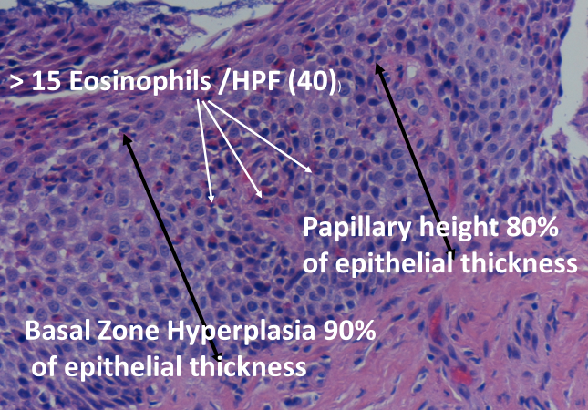
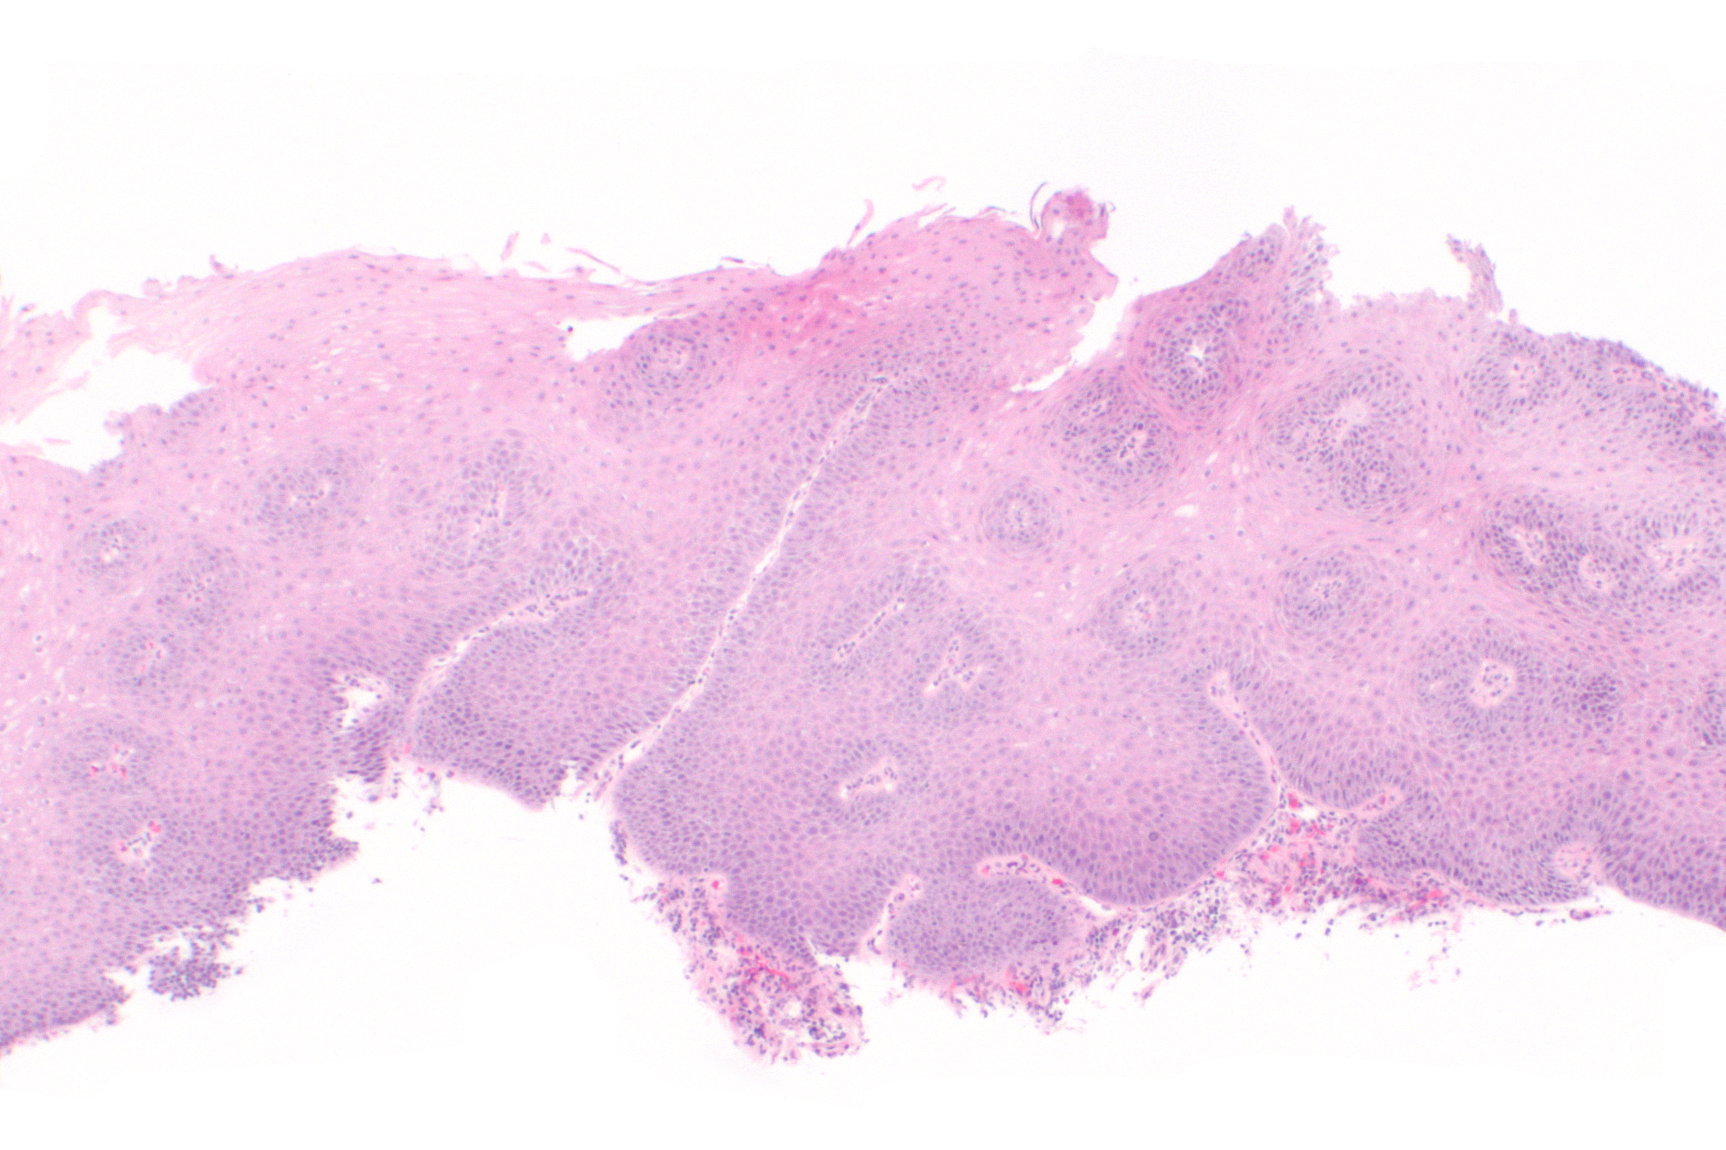
EoE and GORD have differences in their histological presentations¹
EoE
GORD
EoE: eosinophilic oesophagitis
GORD: gastro-oesophageal reflux disease
hpf: high power field
1. Wong S et al. World J Gastrointest Pathophysiol 2018; 9(3): 63-72.

Slide 10
EoE and GORD have differences in their histological presentations¹
EoE
This is a typical esophageal squamous epithelium affected
by EoE
While all the features are commonly seen in EoE, the ones that differentiate the inflammation from GORD are the density of eosinophils (>15/hpf) and the surface layering of eosinophils
Surface layering of eosinophils
Dilated intracellular spaces – can also be seen in GORD
EoE: eosinophilic oesophagitis
GORD: gastro-oesophageal reflux disease
hpf: high power field
1. Wong S et al. World J Gastrointest Pathophysiol 2018; 9(3): 63-72.

Slide 11
EoE and GORD have differences in their histological presentations¹
GORD
This example does not show dilated intracellular spaces, but such features do not distinguish GORD from EoE
Rare scattered intraepithelial eosinophils: <5/hpf
Elongation of the papillae: 90% of epithelial thickness
Basal cell hyperplasia:
50% of epithelial thickness
Scattered lymphocytes
and neutrophils
EoE: eosinophilic oesophagitis
GORD: gastro-oesophageal reflux disease
hpf: high power field
1. Wong S et al. World J Gastrointest Pathophysiol 2018; 9(3): 63-72.

Slide 12
Using intercellular IgG4 staining to distinguish GORD from EoE
While the exact role that IgG4 plays in the pathogenesis of EoE is uncertain, the prevalence of a positive intercellular IgG4 stain was significantly higher in the EoE patients than those with GORD (79% vs 7%; p<0.0001)¹
Diagnostic utility of positive IgG4 staining in EoE¹
Retrospective review of prospectively collected data from patients at a large tertiary referral hospital in Australia over a 3-year period
Sensitivity
77%
Specificity
93%
Positive predictive value
92%
Negative predictive value
80%
0%
20%
40%
60%
80%
100%
A statistically significant correlation was found between positive oesophageal IgG4 staining with food bolus obstruction, dysphagia to solids, and fixed rings¹
Wong S et al. JGH Open 2020; 4(5): 851-5.
EoE: eosinophilic oesophagitis
GORD: gastro-oesophageal reflux disease

Slide 13
An endoscopy performed with a patient on PPIs cannot exclude EoE¹
PPIs can inhibit eosinophil migration and reduce eosinophil counts, thus masking the diagnosis of EoE²
    – as such, it is usually recommended to withdraw PPI therapy for at least 3 weeks prior to endoscopy
If PPIs have not been withdrawn for this period and EoE remains a possible diagnosis following initial endoscopy and biopsies, the BSG recommend repeating the endoscopy and biopsies, after at least
3 weeks off PPIs to definitively exclude EoE³
Whether PPIs have been discontinued and for how long should be clearly documented on the endoscopy report and histology request form³
3
weeks
Odiase E et al. Gastroenterology 2018; 154(5): 1217–21.
Dhar A et al. Frontline Gastroenterol 2022; 13(e1): e51-6.
Dhar A et al. Gut 2022; 71(8): 1459-87.
BSG: British Society of Gastroenterology
EoE: eosinophilic oesophagitis
PPI: proton pump inhibitor

Slide 14
EoE is the most common underlying cause of food bolus obstruction¹
BSG guidelines state FBO patients should be referred for therapeutic OGD with 6 biopsies taken at two levels during the index endoscopy²
    unfortunately, lack of knowledge of EoE as the most common cause of FBO means that biopsies are often not taken, leading to lengthy treatment delays/recurrence in many patients³⁻⁸
Management of FBO patients at a university hospital in Scotland⁴
OGDs performed
Biopsies taken when
OGD performed
≥6 samples when
biopsies taken
<10%
65%
40%
When biopsies cannot be obtained at FBO, empiric PPI medications should
be avoided due to the potential risk of masking EoE at later biopsy⁹
Miehlke S et al. Therap Adv Gastroenterol 2020; 13: 1756284820927282.
Dhar A et al. Gut 2022; 71(8): 1459-87.
Attwood S, Epstein J. Frontline Gastroenterol 2021; 12(7): 644-9.
Ntuli Y et al. Frontline Gastroenterol 2020; 11(1):
11-15.
Marashi Nia SF et al. Dis Esophagus 2020; 33(5): doz103.
Donohue S et al. Am J Gastroenterol 2019; 114: S269.
Chang JW et al. Dis Esophagus 2019; 32(12): doz056.
Lenz CJ et al. Dis Esophagus 2019; 32(4): doz010.
Hillman L et al. Dis Esophagus 2021; 34(11): doab030.
EoE: eosinophilic oesophagitis
BSG: British Society of Gastroenterology
FBO: food bolus obstruction
OGD: oesophagogastroduodenoscopy
PPI: proton pump inhibitor

Slide 15
Royal Free Foundation Trust
Adherence to ACG guidelines for biopsy, histological reporting and management of EoE¹
Retrospective study of patients with a diagnosis of EoE at a large London Trust over 2 years from December 2014
n=30 patients
93%
% of patients who had <6 biopsies
% of these patients who had both proximal and distal biopsies
% of reports not specifying the number of eos/hpf
% of patients with no clear follow-up in their clinical records
7%
50%
40%
Diagnosis of EoE falls short in the number of oesophageal biopsies obtained, biopsy locations and the reporting of biopsy results
Sullivan A et al. Gut 2017; 66(Suppl.2): A187-8.
ACG: American College of Gastroenterology
EoE: eosinophilic oesophagitis
eos/hpf: eosinophils/high power field

Slide 16
North Denmark experience
EoE diagnosis rates can be improved by education¹
Leaders of regional endoscopy units attended a consensus meeting where a biopsy protocol for dysphagia patients was agreed:¹
• Take 8 biopsy samples (4 from 4 cm and 14 cm above the oesophagogastric junction) regardless of the macroscopic appearance • Code eosinophilia (≥15 eos/hpf) systematically in the pathology registry
After an infographic of the biopsy protocol was sent to all endoscopy units and the amended instructions for biopsy analysis sent to pathologists:¹
the number of biopsy samples per patient doubled the number of patients with oesophageal eosinophilia detected each year increased 50-fold
“an intervention as simple as a 2-hour consensus meeting followed by dissemination of information sheets, can lead to a dramatic change in practice with a real impact on everyday clinical care”²
Krarup AL et al. Endoscopy 2021; 53(1): 15-24.
Vanuytsel T. Endoscopy 2021; 53(1): 25-6.
EoE: eosinophilic oesophagitis
eos/hpf: eosinophils/high power field

Slide 17
Looking to the future: Non-invasive tests for EoE
Oesophageal eosinophilia is currently identified
by OGD, an invasive and costly procedure¹
In recent years, much effort has been made toward developing minimally invasive techniques to measure disease activity in EoE:^{1,2}
    to decrease reliance on repeated endoscopies
    to provide non-GI practitioners a means to evaluate disease activity in the oesophagus
    to improve access to care in areas in where EoE specialists are limited
    to identify patients with EoE in a timely fashion,
    and as early as possible
“At present, no biomarker displays a high accuracy, wide availability, and disease specificity, and hence cannot yet be incorporated into clinical guidelines or routinely adopted into clinical practice”²
McGowan EC, Aceves SS. Ann Allergy Asthma Immunol 2022; 129(1): 27-34.
Rossi CM et al. Lancet Gastroenterol Hepatol 2022; 7(3): 202-3.
EoE: eosinophilic oesophagitis
OGD: oesophagogastroduodenoscopy
GI: gastrointestinal

Slide 18
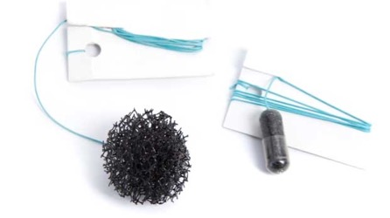
Use of the cytosponge for assessing histologic activity in EoE
The cytosponge consists of an ingestible gelatin capsule containing a compressed mesh sponge attached to a string which is released in the stomach¹
The sponge is withdrawn through the mouth using the attached string, collecting a tissue specimen as it passes through the oesophagus¹
After centrifuging the cytosponge specimen, the sample is processed through routine cytology laboratory techniques¹
In a recent study, the cytosponge successfully obtained adequate tissue samples in 95% of EoE patients, with 80% accuracy compared to a gold standard of endoscopy with biopsy:¹
 | Endoscopic biopsy
 | ≥15 eos/hpf | <15 eos/hpf
Cytosponge
≥15 eos/hpf | 43 | 6
<15 eos/hpf | 14 | 38
1. Katzka DA et al. Am J Gastroenterol 2017; 112(10): 1538-44.
EoE: eosinophilic oesophagitis
eos/hpf: eosinophils/high power field

Slide 19
Use of the oesophageal string test for assessing histologic activity in EoE
Measurement of eosinophil-associated protein in
the oesophageal mucosa may serve as valuable measures of disease activity in EoE^{1,2}
The oesophageal string test consists of a weighted gelatin capsule containing a
nylon string
    – One end of the string is first pulled from the capsule and taped to the patient’s cheek
    – The patient swallows the capsule which travels
    to the duodenum, remaining in place for 1 hour
    – The oeosophageal portion of the string is
    assayed for EAPs
A 1-hour EST has been shown to accurately distinguish active from inactive EoE:²
Prospective, 5-centre study
134 patient (aged 7 to 55 years)
Confirmed/suspected EoE
OGD + EST within 4 hours of the endoscopy
EAPs evaluated in the EST eluate and
oesophageal tissue
Results
EST-captured EAPs correlated with:
peak eosinophils/high-power field,
endoscopic visual scoring
the same proteins extracted from
mucosal biopsies
1. Furuta GT et al. Gut 2013; 62(10): 1395-405.
2. Ackerman SJ et al. Am J Gastroenterol 2019; 114(10): 1614-25.
EAP: eosinophil-associated protein
EoE: eosinophilic oesophagitis
EST: oesophageal string test
OGD: oesophago-gastro-duodenoscopy

Slide 20
Prescribing information
Please click on the following link for the prescribing information:
https://www.drfalk.co.uk/jorveza-1mg-oro-dipsersible-tablet/
Jorveza® (budesonide) is indicated for the treatment of eosinophilic oesophagitis (EoE) in adults (older than 18 years of age)
Adverse events should be reported. Reporting forms and information can be found at www.yellowcard.mhra.gov.uk (UK residents) or www.hpra.ie (Irish residents). Adverse events should also be reported to Dr Falk Pharma UK Ltd at pv@drfalkpharma.co.uk.
www.drfalk.co.uk
Dr Falk Pharma UK Ltd, Unit K, Bourne End Business Park, Cores End Rd, Bourne End, SL8 5AS Registered in England No: 2307698
UK--2200225 Date of preparation: January 2023

