Slide 1
Food bolus obstruction: incidence, management and follow-up
www.drfalk.co.uk
Dr Falk Pharma UK Ltd, Unit K, Bourne End Business Park, Cores End Rd, Bourne End, SL8 5AS Registered in England No: 2307698
UK--2200128 Date of preparation: July 2022

Slide 2
Food bolus obstruction is the most common gastrointestinal emergency after GI bleeding^{1,2}
This estimate of incidence comes from a population-based study examining admissions for FBO from 2008 to 2013 in Iceland:¹
Estimated FBO incidence
Food type involved
16%
25
4%
Meat
Fish
Vegetables
Other
12%
25 people per 100,000 per year
68%
A study of patients admitted to a tertiary referral hospital in Southern Australia found the number of FBOs increased significantly over the 15 years to 2010:³
2006-2010
180 cases
1996-2000
39 cases
2001-2005
96 cases
1. Gretarsdottir HM et al. Scand J Gastroenterol 2015; 50(5): 513-8.
2. Fulforth JM et al. Emerg Med Australas 2019; 31(5): 745-9.
Mahesh VN et al. J Gastroenterol Hepatol 2013; 28(6): 963-6.
FBO: food bolus obstruction
GI: gastrointestinal

Slide 3
Eosinophilic oesophagitis is the most common underlying cause of food bolus obstruction^{1,2}
The prevalence of EoE is rapidly growing and, with it, EoE-related food obstruction^{3,4}
80
60
40
20
0
63.2
FBOs are often the first presentation for patients with EoE⁵
The presence of EoE is strongly predictive of recurrent FBOs,
underscoring the importance of establishing the underlying diagnosis^{6,7}
49.2
Prevalence of EoE / 100,000
30.1
15.4
Prior
to 2007
2007 –
2011 –
Post
2017
2011
2017
1. Miehlke S et al. Therap Adv Gastroenterol 2020; 13: 1756284820927282.
2. Ntuli Y et al. Frontline Gastroenterol 2020; 11(1): 11-5.
3. Dellon ES. Aliment Pharmacol Ther 2019; 49 (11): 1448-9.
4. Lenz CJ et al. Dis Esophagus 2019; 32(4): doz010.
5. Hillman L et al. Dis Esophagus 2021; 34(11): doab030.
6. Sperry SLW et al. Gastrointest Endosc 2011; 74(5): 985-91.
7. Fulforth JM et al. Emerg Med Australas 2019; 31(5): 745-9.
EoE: eosinophilic oesophagitis
FBO: food bolus obstruction

Slide 4
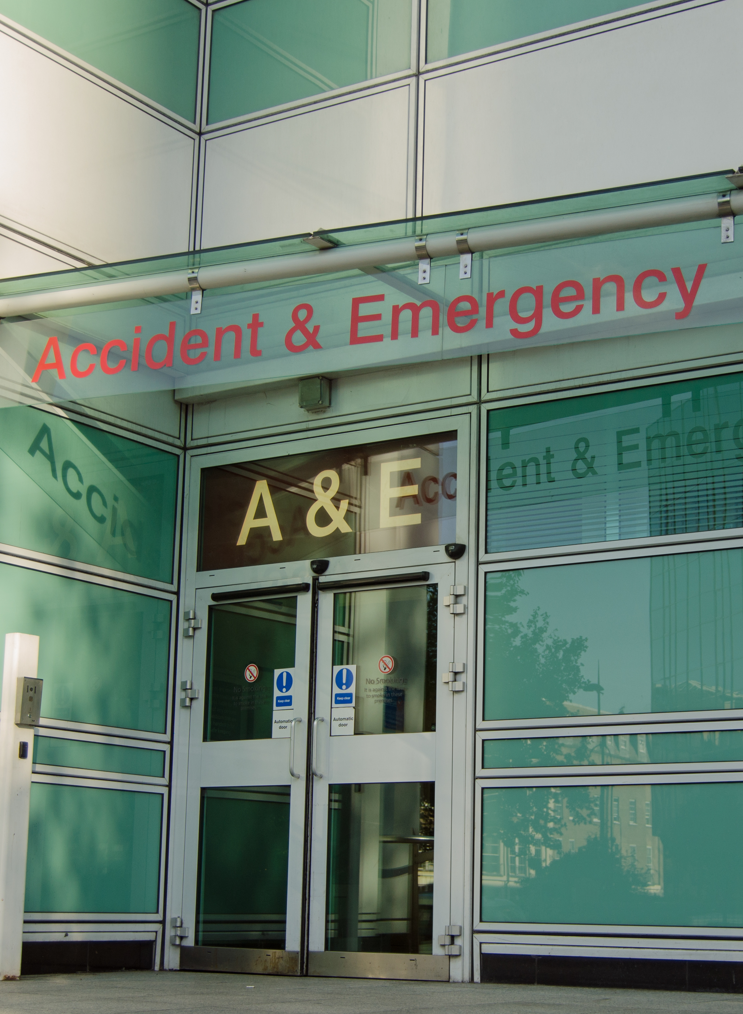
Most patients will present to an emergency department within four hours of the obstruction^{1,2}
Generally speaking, patients immediately recognise an FBO, experiencing a sensation
of squeezing in the chest³
Typically, they will try to wash the food down into the stomach with water or attempt to regurgitate the ingested contents⁴
If that fails and symptoms of obstruction persist and/or are accompanied by substantial chest discomfort, they will seek medical attention³
1. Fulforth JM et al. Emerg Med Australas 2019; 31(5): 745-9.
2. Attwood S, Epstein J. Frontline Gastroenterol 2021; 12(7): 644-9.
3. Ginsberg GG. Gastroenterol Hepatol (N Y) 2007; 3(2): 85-6.
4. Larsson H, Attwood S. BMC Gastroenterol 2020; 20(1): 185.
FBO: food bolus obstruction

Slide 5
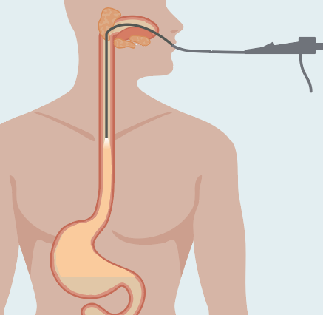
Management aims in food bolus obstruction
Flexible endoscopy is recommended first-line for FBO:^{1,3}
OGD is highly effective with a success rate >95%
serious complications are rare
predisposing pathological processes can be identified
1
2
To treat patients in an effective and timely manner to relieve symptoms and prevent aspiration of gastric contents or oesophageal perforation^{1,2}
To identify the underlying pathology in order to inform future management^{1,2}
Flexible endoscopy is recommended first-line for FBO:^{1,3,4}
OGD is highly effective with a success rate >95%
Serious complications are rare
Predisposing pathological processes can be identified
1. Fulforth JM et al. Emerg Med Australas 2019; 31(5): 745-9.
2. Sharma A, Philpott H. Dig Dis Sci 2018; 63(6): 1371-3.
Hackett R et al. Clin Exp Gastroenterol 2021; 14: 237-47.
Dhar A et al. Gut 2022; doi: 10.1136/gutjnl-2022-327326.
FBO: food bolus obstruction
OGD: oesophagogastroduodenoscopy

Slide 6



Management of food bolus obstruction varies widely in practice¹⁻³
While urgent referral to gastroenterology for flexible OGD is warranted, the lack of guidance
means FBO is also managed by emergency medics, ENT and general surgeons³⁻⁶
Admission of FBO patients at a university hospital in Scotland³
Single
UK centre
January 2008
to August 2014
n=211 patients
(310 episodes)
ICD 10 code T18.1:
‘foreign body
in oesophagus’
68%
32%
Admitting speciality
Unless the patient’s airway is compromised, FBO management by gastroenterology offers a unique opportunity to diagnose, treat and establish care for patients with EoE^{7,8}
General medicine
9.7%
ENT
46.8%
General surgery
43.5%
1. Hillman L et al. Dis Esophagus 2021; 34(11): doab030.
2. Fulforth JM et al. Emerg Med Australas 2019;
31(5): 745-9.
3. Ntuli Y et al. Frontline Gastroenterol 2020; 11(1):
11-15.
Hiremath G et al. Dig Dis Sci 2018; 63(6): 1428-37.
5. Stubington TJ, Kamani T. Eur Arch Otorhinolaryngol 2021; 278(10): 3613-23.
Marano L et al. BMC Gastroenterol 2016; 16(1): 95.
7. Attwood S, Epstein J. Frontline Gastroenterol 2021; 12(7): 644-9.
8. Donohue S et al. Am J Gastroenterol 2019; 114: S269.
ENT: ear, nose and throat
EoE: eosinophilic oesophagitis
FBO: food bolus obstruction
ICD: International Classification of Diseases
OGD: oesophagogastroduodenoscopy

Slide 7
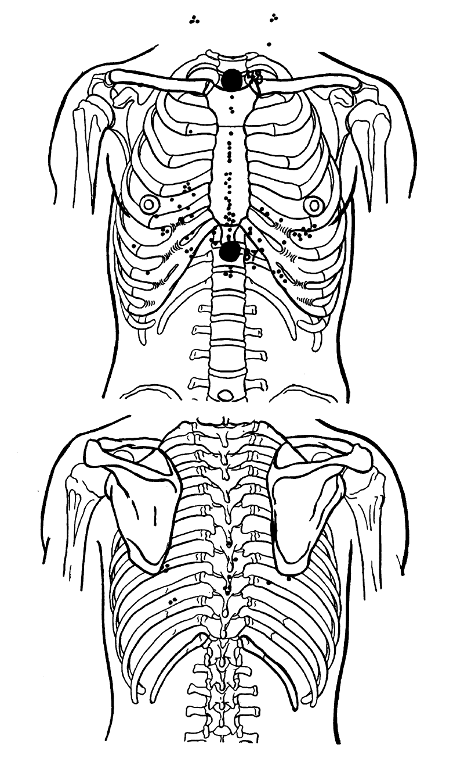
Obstruction of a food bolus commonly occurs in the upper third of the oesophagus¹
Localisation of symptoms is, however, of limited usefulness since referred pain
may bear no relation to the position of the obstruction^{2,3}
    the sensation of a retained foreign body can also last for several hours
    after a large food bolus has cleared the oesophagus¹
In a 1931 study, small balloons were inflated at various levels in the oesophagus³
The site of referred pain was in
the suprasternal notch in 25%
of cases, and at the xyphoid
46% of the time, regardless of
the stimulus site³
^{Response to one inflation}
1. Hackett R et al. Clin Exp Gastroenterol 2021; 14: 237-47.
2. Stubington TJ, Kamani T. Eur Arch Otorhinolaryngol 2021; 278(10): 3613-23.
3. Polland WS, Bloomfield AL. J Clin Invest 1931; 10(3): 435-52.

Slide 8
Caution should be exercised using any conservative management strategies in FBO^{1,2}
Several treatments have been used to try to clear FBOs, including muscle relaxants, antispasmodics, effervescent drinks and pineapple juice^{1,3}
Use of medical therapy prior to OGD⁴
Multicentre
June 2010 to December 2019
n=227 OGDs
(195 FBOs)
New Zealand
endoscopy database
63%
37%
Medical therapies prior to endoscopy referral
A recent Cochrane review concluded that there are inadequate data to recommend use of any enteral or parenteral treatments in FBO management¹
– data are also lacking regarding associated adverse events
– their use may also delay definitive
endoscopic treatment
41.4%
1. Hardman J et al. Cochrane Database Syst Rev 2020; 2020(5): CD007352.
2. Fulforth JM et al. Emerg Med Australas 2019; 31(5): 745-9.
3. Attwood S, Epstein J. Frontline Gastroenterol 2021; 12(7): 644-9.
4. Hackett R et al. Clin Exp Gastroenterol 2021; 14: 237-47.
FBO: food bolus obstruction
OGD: oesophagogastroduodenoscopy

Slide 9
Diagnostic biopsies should be taken at the therapeutic endoscopy¹
BSG guidelines state FBO patients should be referred for therapeutic OGD with 6 biopsies taken at two levels during the index endoscopy²
    unfortunately, lack of knowledge of EoE as the most common cause of FBO means that biopsies
    are often not taken, leading to lengthy treatment delays/recurrence in many patients³⁻⁸
Management of FBO patients at a university hospital in Scotland⁴
OGDs performed
Biopsies taken when
OGD performed
≥6 samples when
biopsies taken
<10%
65%
40%
When biopsies cannot be obtained at FBO, empiric PPI medications should
be avoided due to the potential risk of masking EoE at later biopsy⁹
Birk M et al. Endoscopy 2016; 48(5): 489-96.
Dhar A et al. Gut 2022; doi:10.113/gutjnl-2022-327326.
Attwood S, Epstein J. Frontline Gastroenterol 2021; 12(7): 644-9.
Ntuli Y et al. Frontline Gastroenterol 2020; 11(1):
11-15.
Marashi Nia SF et al. Dis Esophagus 2020; 33(5): doz103.
Donohue S et al. Am J Gastroenterol 2019; 114: S269.
Chang JW et al. Dis Esophagus 2019; 32(12): doz056.
Lenz CJ et al. Dis Esophagus 2019; 32(4): doz010.
Hillman L et al. Dis Esophagus 2021; 34(11): doab030.
EoE: eosinophilic oesophagitis
BSG: British Society of Gastroenterology
FBO: food bolus obstruction
OGD: oesophagogastroduodenoscopy
PPI: proton pump inhibitor

Slide 10

Appropriate follow-up can help prevent further episodes of food obstruction¹
A proportion of FBO may be prevented by focusing on appropriate patient diagnostic work-up after the first episode of obstruction, even if the episode was transient and self-resolving¹
At a UK district general hospital, only 1 in 3 patients had diagnostic follow-up post FBO removal²
Failure to follow up is a predictor of recurrent obstructions³
At a UK university hospital, 38% of patients newly diagnosed with EoE had received up to three OGDs for prior episodes of food obstruction before their diagnosis⁴
Too many opportunities to diagnose EoE are therefore being missed with a delay
in the commencement of effective treatment⁴
1. Ferrari D et al. Eur J Gastroenterol Hepatol 2020; 32(7): 827-31.
2. Arman S et al. Otolaryngol Pol 2019; 74(3): 29-32.
3. Hillman L et al. Dis Esophagus 2021; 34(11): doab030.
4. Ntuli Y et al. Frontline Gastroenterol 2020; 11(1): 11-5.
EoE: eosinophilic oesophagitis
FBO: food bolus obstruction
OGD: oesophagogastroduodenoscopy

Slide 11

Preventing food bolus obstruction
EoE is the most common underlying aetiology
in patients presenting with FBO^{1,2}
The prevalence of EoE is rapidly growing and, with it,
EoE-related food obstruction^{3,4}
Lack of knowledge of EoE as the most common cause means that in many cases biopsies are not being taken⁵
As a result, there may be lengthy delays in diagnosis and initiation of appropriate EoE treatment, not to mention, recurrent obstruction⁵⁻⁷
It is likely that some FBOs can be prevented with appropriate diagnostic work-up, even if an episode
is transient and self-resolving⁸
1. Miehlke S et al. Therap Adv Gastroenterol 2020; 13: 1756284820927282.
2. Ntuli Y et al. Frontline Gastroenterol 2020; 11(1): 11-5.
3. Lenz CJ et al. Dis Esophagus 2019; 32(4): doz010.
4. Dellon ES. Aliment Pharmacol Ther 2019; 49 (11): 1448-9.
5. Attwood S, Epstein J. Frontline Gastroenterol 2021; 12(7): 644-9.
6. Hackett R et al. Clin Exp Gastroenterol 2021; 14: 237-47.
7. Hillman L et al. Dis Esophagus 2021; 34(11): doab030.
8. Ferrari D et al. Eur J Gastroenterol Hepatol 2020; 32(7): 827-31.
EoE: eosinophilic oesophagitis
FBO: food bolus obstruction

