Slide 1
Maintenance of remission in eosinophilic oesophagitis with
Jorveza (orodispersible budesonide)

Slide 2

The new BSG guidelines recommend maintenance therapy for EoE¹
Clinical and histological relapse is high after
withdrawal of topical steroid treatment and,
following clinical review, maintenance treatment should be recommended¹
Grade of evidence: Moderate
Level of recommendation: Strong
The BSG recommend Jorveza (orodispersible budesonide) – the only medicine with European regulatory approval for EoE – over other steroid formulations for both the induction and maintenance of remission in adults¹
Dhar A et al. Gut 2022; 71(8): 1459-87.
BSG: British Society of Gastroenterology
EoE: eosinophilic oesophagitis

Slide 3
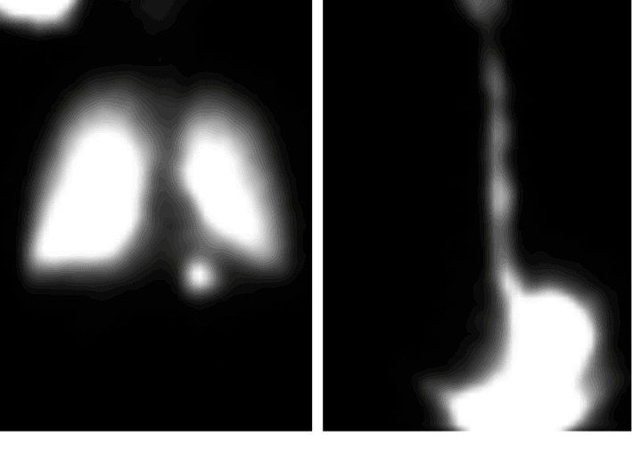
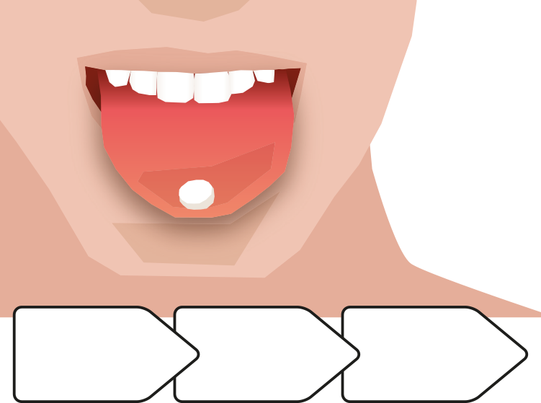
The most effective specific therapy for EoE is topical steroid treatment¹
Topical steroids are, however, only as effective as their ability to effectively uniformly coat the oesophageal mucosa²
Off-label formulations do not provide a standardised way of getting topical steroids to the surface of the oesophagus^{3,4}
Jorveza is the only topical steroid specifically designed to target the oesophagus in patients with EoE⁵
Orodispersible tablet
Stimulates
saliva
Coats the oesophagus
Nebulised
and swallowed steroid
Oral steroid slurry
Delivers budesonide to the site of inflammation
Reprinted from Gastroenterology, vol. 143, issue 2, Evan S. Dellon et al, Viscous Topical Is More Effective Than Nebulized Steroid Therapy for Patients With Eosinophilic Esophagitis, 321-324,
© 2012 with permission from Elsevier.
1. Attwood S, Epstein J. Frontline Gastroenterol 2020; 12(7): 1644-9.
2. Katzka DA et al. Gastroenterology 2020; 159(3): 813-15.
3. Dellon ES et al. Gastroenterology 2017; 152(4): 776-86.
4. Dellon ES et al. Gastroenterology 2012; 143(2): 321-4.
5. Miehlke S et al. Therap Adv Gastroenterol 2020; 13: 1756284820927282.
EoE: eosinophilic oesophagitis

Slide 4

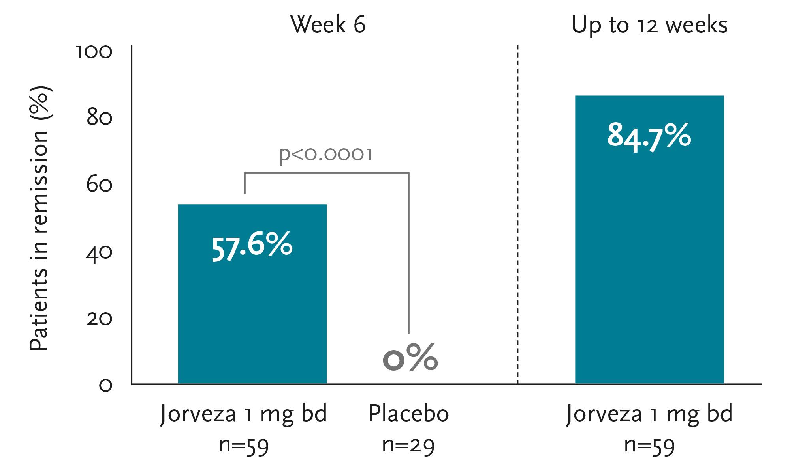

Jorveza 1 mg bd rapidly improves EoE symptoms and reduces disease activity¹
Clinical-histological remission with orodispersible Jorveza 1 mg bd
induction therapy¹
Primary endpoint:
Rate of clinico-histological remission
Histology: <5 eos/hpf
Dysphagia: ≤2 points (NRS 0-10)
Odynophagia: ≤2 points (NRS -10)
Prolongation of Jorveza therapy to 12 weeks is beneficial to bring more patients into clinico-histologic remission¹
Adapted from Lucendo¹
1. Lucendo AJ et al. Gastroenterology 2019; 157: 74-86.
EoE: eosinophilic oesophagitis
eos: eosinophils
hpf: high-power field
NRS: numerical rating scale

Slide 5
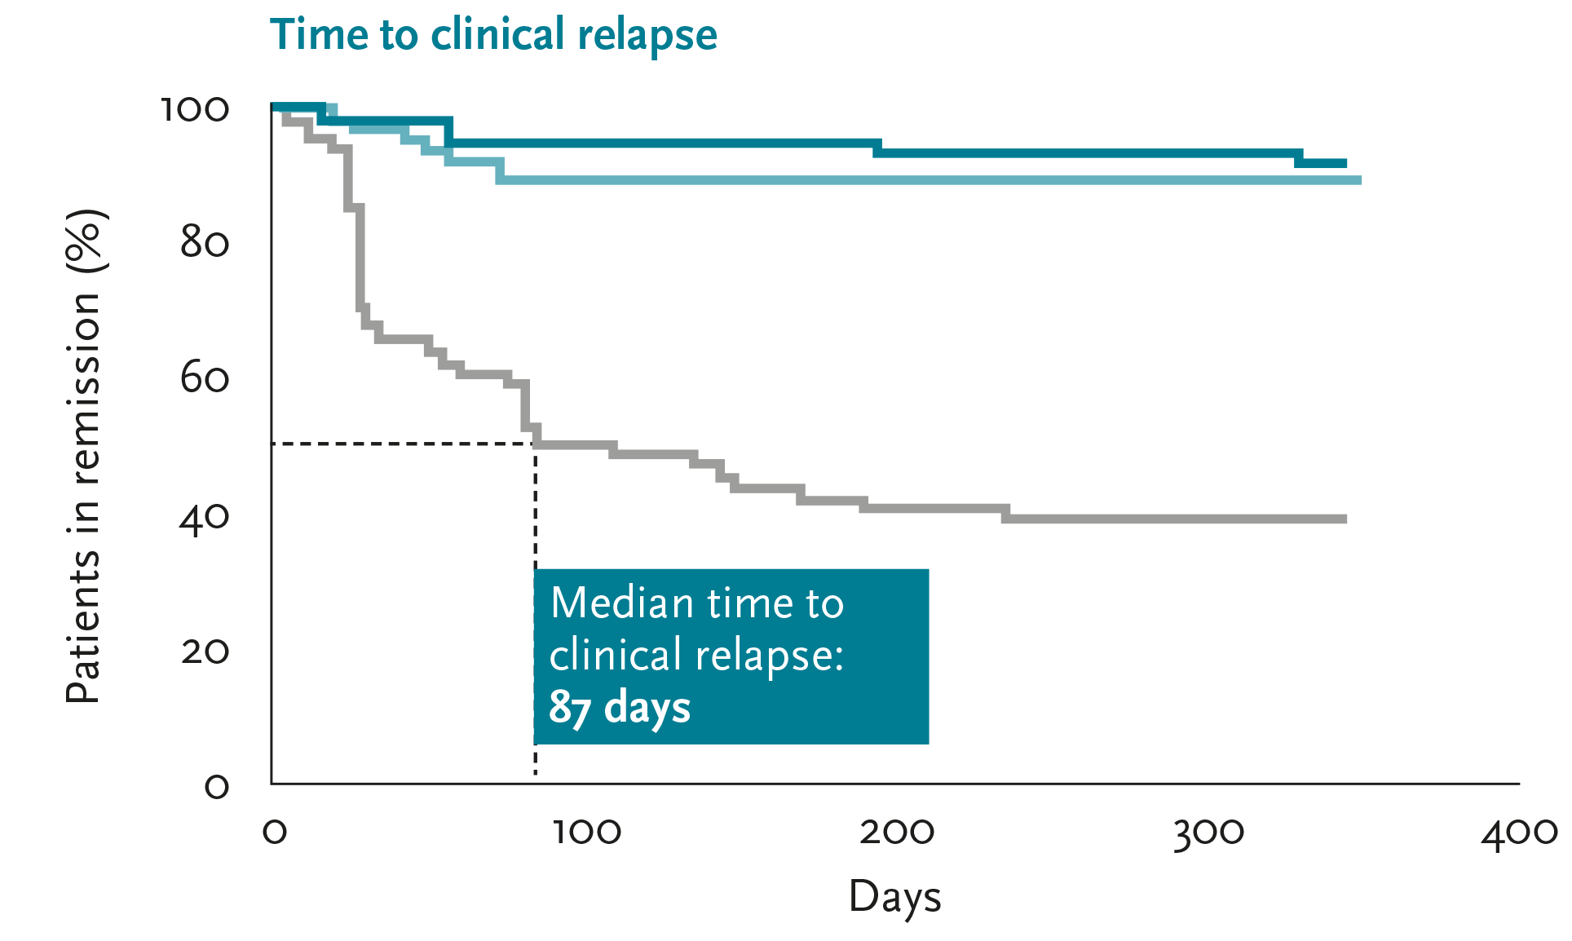
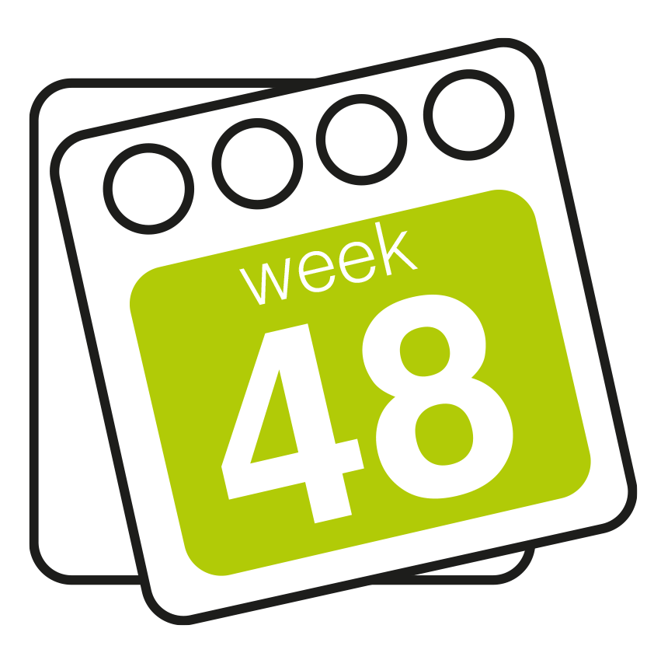


Jorveza is highly effective at maintaining remission in patients with EoE¹
Clinical remission
While half of placebo patients had relapsed within 3 months,
over 90% of Jorveza patients were still in remission at week 48¹
Histological remission
90% of placebo patients had experienced a histological relapse versus
only 12% of Jorveza patients at week 48¹
Maintenance
Jorveza 1 mg bd n=68
Jorveza 0.5 mg bd n=68
Placebo n=68
Adapted from Straumann¹
“
This study reported greater efficacy than all previous studies on maintenance therapy using swallowed inhaled topical steroids²
“
1. Straumann A et al. Gastroenterology 2020; 159(5): 1672-85.
2. Dhar A et al. Gut 2022; 71(8): 1459-87.
EoE: eosinophilic oesophagitis

Slide 6
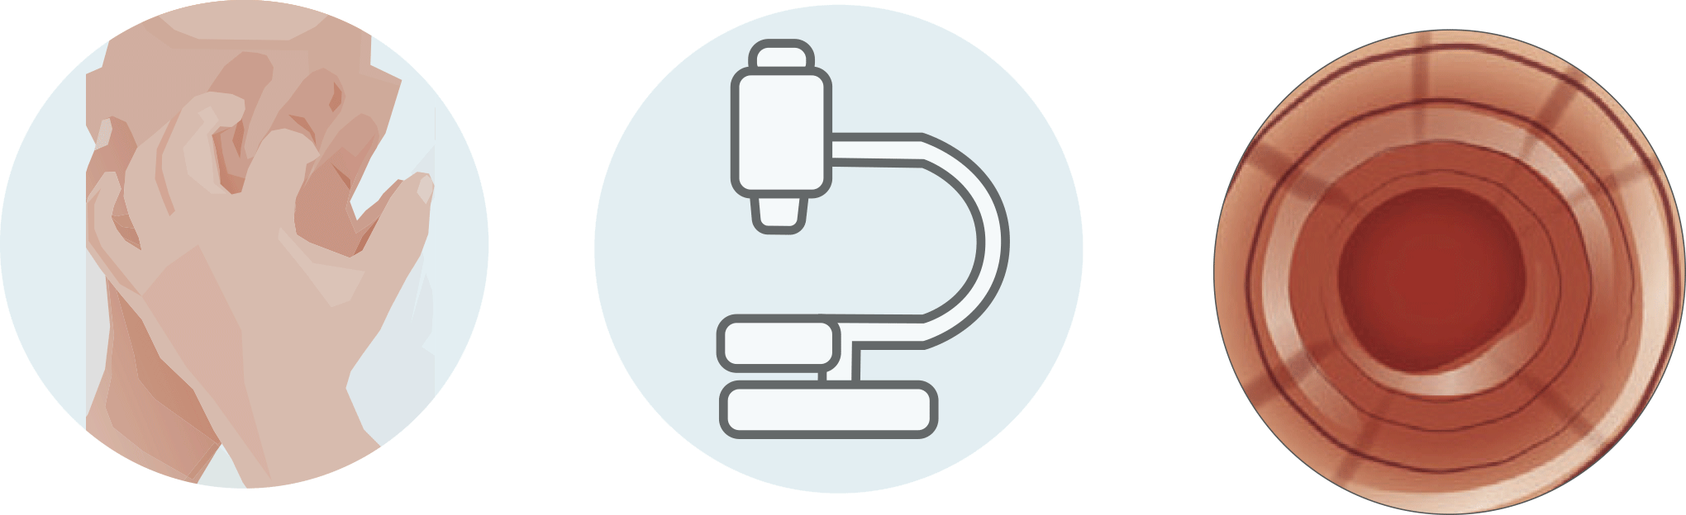

All secondary efficacy outcomes confirmed superiority of Jorveza over placebo¹
Clinical remission
(EEsAI-PRO ≤20)
Deep histological
remission
(0 eos/mm² hpf)
Deep endoscopic
remission
(no signs of EoE)
p<0.001
100
75
50
25
0
p<0.001
100
75
50
25
0
p<0.001
100
75
50
25
0
p<0.001
p<0.001
79.4%
76.5%
p<0.001
73.5%
72.1%
73.5%
67.5%
% patients
% patients
% patients
20.6%
7.4%
1.5%
Jorveza 1.0 mg bd n=68 Jorveza 0.5 mg bd n=68 Placebo n=68
Straumann A et al. Gastroenterology 2020; 159(5): 1672-85.
EEsAI-PRO: EoE Activity Index-Patient Reported Outcome
EoE: eosinophilic oesophagitis
eos: eosinophil
hpf: high power field

Slide 7
Jorveza can reduce the emotional and social toll of EoE long-term (EoE-QoL-A )¹
EoE-QoL-A significantly improved in all domains with Jorveza 0.5 mg and 1 mg twice daily, but deteriorated
with placebo
Change from baseline in EoE-QoL-A 30 score at week 48
p<0.001
Bearing in mind that all patients started with an already very good QoL, the relative improvement and deterioration under Jorveza and placebo respectively are
clinically relevant
10
8
6
4
2
0
-2
-4
-6
-8
-10
+9.4%
p<0.001
+6.3%
% patients
-6.7%
Jorveza
1 mg bd
n=68
Jorveza
0.5 mg bd
n=68
Placebo
n=68
Straumann A et al. Gastroenterology 2020; 159(5): 1672-85.
EoE: eosinophilic oesophagitis
EoE-QoL-A: Eosinophilic Oesophagitis Quality of Life Scale for Adults
QoL: quality of life

Slide 8
Jorveza can reduce the emotional and social toll of EoE long-term (modSHS)¹
The modSHS is a responsive measure of subjective health that has been previously used in ulcerative colitis, collagenous colitis and Crohn’s disease patients
A significant and clinically relevant deterioration in all four QoL scales was observed in the placebo group
Increase in
symptom burden
Deterioration in
social function
Increase in
disease-related worry
Deterioration in
general well-being
p<0.0001
p<0.0001
25
20
15
10
5
0
-5
23
25
20
15
10
5
0
-5
p=0.0003
25
20
15
10
5
0
-5
-10
p<0.0001
25
20
15
10
5
0
-5
p=0.0003
p=0.0041
p=0.0007
14
12
p=0.0022
Change in score
Change in score
Change in score
Change in score
9
1
0
-1
-2
0
-1
-3
-9
Jorveza 1 mg bd n=68 Jorveza 0.5 mg bd n=68 Placebo n=68
Data on file, Dr Falk Pharma.
EoE: eosinophilic oesophagitis
modSHS: modified Short Health Scale
QoL: quality of life

Slide 9

Jorveza can stop progression in endoscopic signs
of fibrotic remodeling¹
Patients with fixed rings (% change from baseline)
+58%
From
38.2% to 30.9%
From
42.6% to 36.8%
1 in 5 patients on placebo developed new fixed rings
vs none on Jorveza maintenance therapy
-19%
-14%
From
38.2% to 60.3%
Jorveza
1 mg bd
n=68
Jorveza
0.5 mg bd
n=68
Placebo
n=68
Biedermann L et al. United Eur Gastroenterol J 2019; 7: 55.

Slide 10
The frequency of adverse events was similar in the Jorveza and placebo groups¹
Food impaction requiring endoscopic intervention occurred in two patients receiving placebo, but in no Jorveza patient
Morning serum levels
of cortisol were in the normal range at baseline and did not significantly change during treatment
Adverse events
Adverse events leading to
drug withdrawal
100
80
60
40
20
0
86.8%
89.7%
100
80
60
40
20
0
83.8%
61.8%
% patients
% patients
11.8%
10.3%
Jorveza 1 mg bd n=68 Jorveza 0.5 mg bd n=68 Placebo n=68
Straumann A et al. Gastroenterology 2020; 159(5): 1672-85.

Slide 11
Jorveza open-label extension
Jorveza open-label extension study design
96-week, open-label extension for patients (placebo and Jorveza completing the double-blind, 48-week study)¹
86% of patients were treated with the lower dose of Jorveza 0.5 mg bd¹
Schlag E et al. Gastroenterology 2022; 162(7): S-213.

Slide 12
Over a period of up to three years, no loss of efficacy was observed with Jorveza¹
Patients in clinical remission with Jorveza 0.5 mg bd
PatGA of EoE activity ≤2 with Jorveza 0.5 mg bd
Total modified EREFS of 0 with Jorveza 0.5 mg bd
100
80
60
40
20
0
100
80
60
40
20
0
95.8%
98.2%
100
80
60
40
20
0
82.5%
77.7%
67.1%
67.1%
% patients
% patients
% patients
n=166
n=166
n=82
Baseline
Week 96
Baseline
Week 96
Baseline
Week 96
Open-label extension
Open-label extension
Open-label extension
Schlag E et al. Gastroenterology 2022; 162(7): S-213.
EoE: eosinophilic oesophagitis
EREFS: endoscopic reference score
PatGA: patients’ global assessment

Slide 13
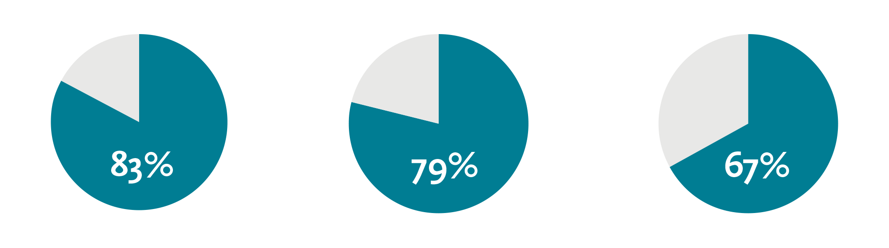
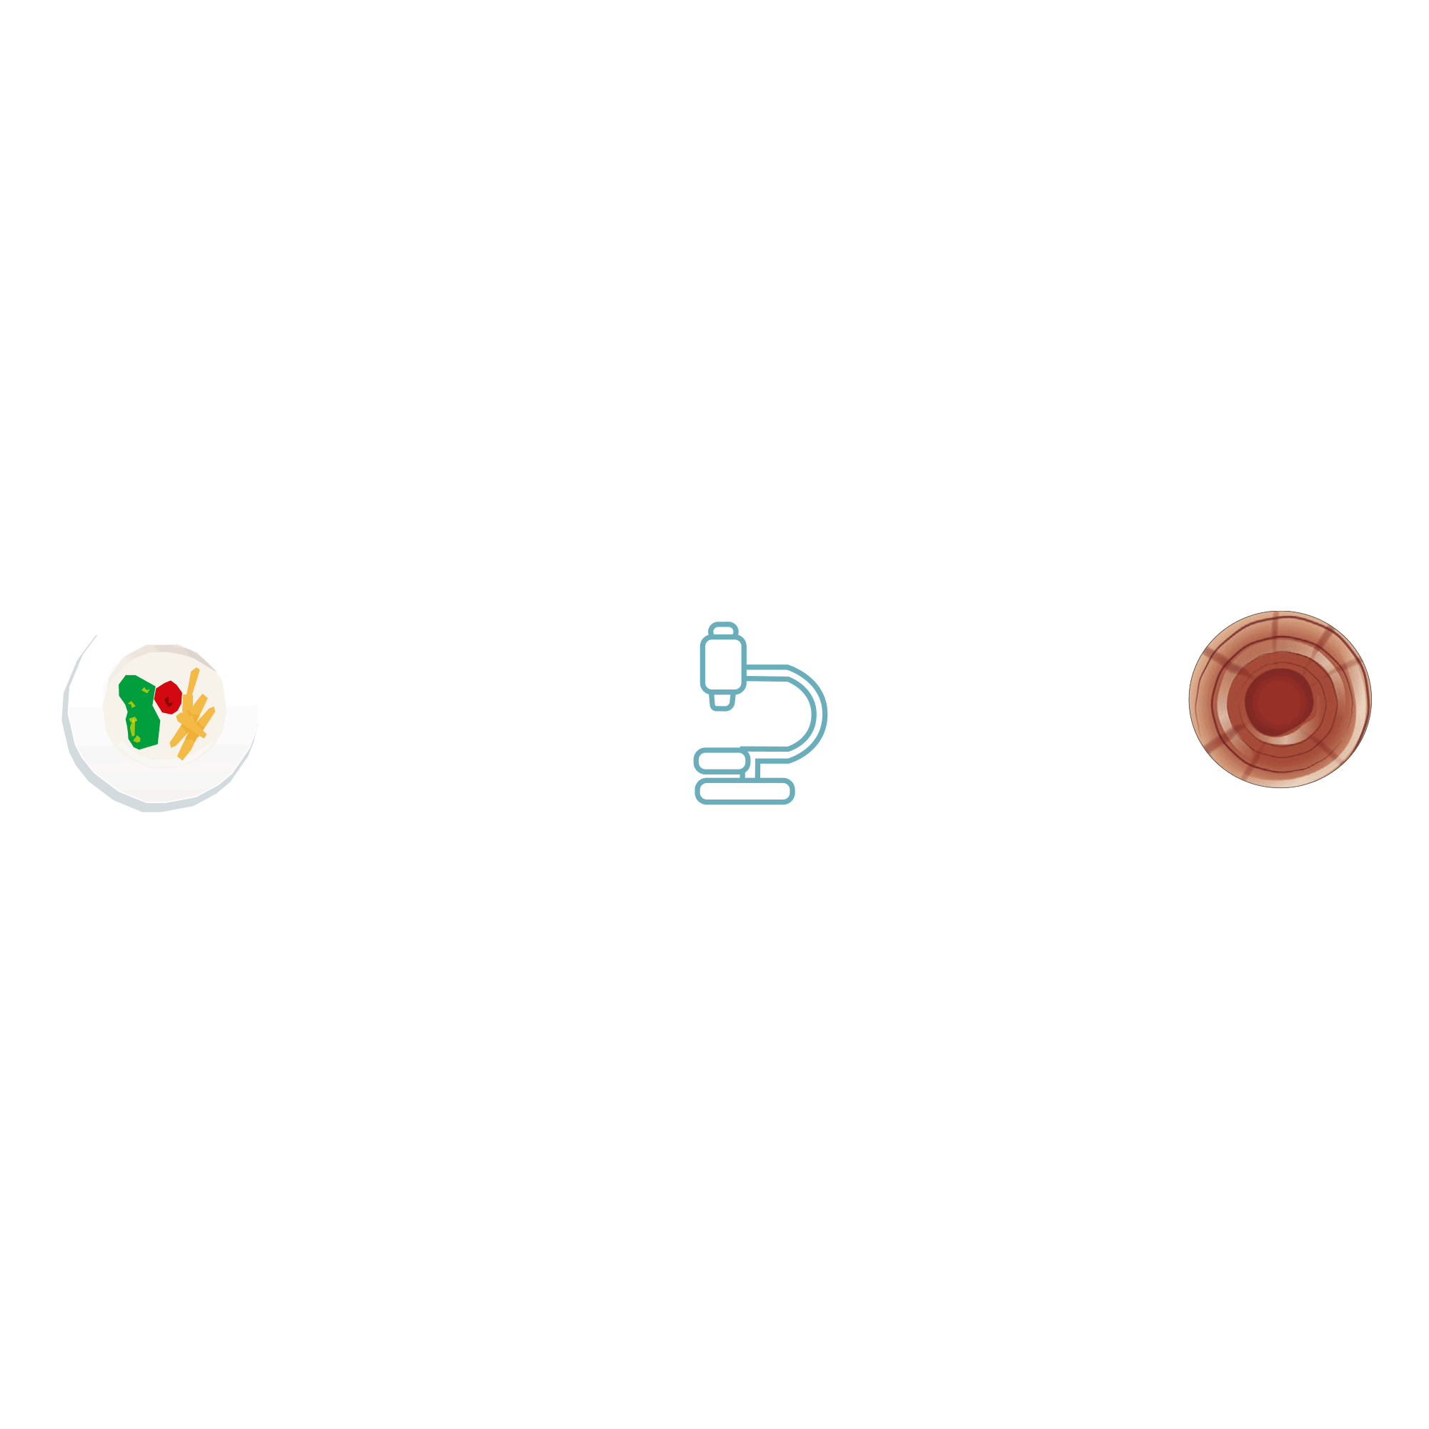

Jorveza provides long-lasting disease control in EoE¹
Patients completing the double-blind, 48-week Jorveza study continued with an open-label extension for a further 96 weeks¹
Clinical remission
(EEsAI-PRO ≤20)
Deep histologic remission
(Peak eos in all biopsies: 0/hpf)
Total EREFS of 0
(Grade 0 for oedema, rings, exudate, furrows & stricture)
n=166
n=146
n=82
Patients’ global satisfaction at the end of DB & OLE treatment
Extremely satisfied:
77.7%
Satisfied:
19.9%
Neither satisfied nor dissatisfied:
0.6%
Schlag E et al. Gastroenterology 2022; 162(7): S-213.
DB: double-blind
EEsAI-PRO: EoE Activity
Index-Patient Reported Outcome
EoE: eosinophilic oesophagitis
eos: eosinophil
EREFS: endoscopic reference score
hpf: high power field
OLE: open-label extension

Slide 14
Over a period of up to three years, no increase in side effects was observed with Jorveza¹
Treatment emergent adverse events led to withdrawal in 5 patients (2.7%)¹
Long-term treatment with Jorveza did not increase the rate of local candidiasis; cases were generally mild in intensity and did not impact upon the treatment effect¹
No clinically relevant changes in serum morning cortisol levels were observed from the open-label extension baseline to the end of treatment¹
Patients’ global satisfaction at end of treatment¹
Extremely satisfied | 77.7%
Satisfied | 19.9%
Neither satisfied nor dissatisfied | 0.6%
Missing | 1.8%
Schlag E et al. Gastroenterology 2022; 162(7): S-213.

Slide 15

Which patients with EoE should maintenance therapy be offered to?
Responded to induction?
Long diagnostic delay before treatment?
Moderate to severe disease activity prior to induction?
Rapid symptom recurrence?
Already has fibrostenotic complications?
Previous FBO requiring emergency extraction?
Previous dilatation?
Anxious about symptoms returning?
Patients with mild EoE phenotypes who are asymptomatic after initial therapy and who opt for as-needed or intermittent therapy should be advised of potential risks of discontinuing treatment and undergo regular follow-up⁴
“
“
Discuss maintenance therapy with the patient
Adapted from references 1 to 8
Round table discussion of UK physicians expert in the treatment of EoE, supported by an educational grant from Dr Falk Pharma.
Dhar A et al. Gut 2022; 71(8): 1459-87.
Greutner T et al. Clin Transl Gastroenterol 2018; 9(12): e212.
Hirano I, Spechler SJ. Gastroenterology 2020; 159(5): 1653-5.
Philpott H, Dellon ES. J Gastroenterol 2018; 53(2): 165-71.
Schupack DA et al. Dig Dis Sci 2021; 66(2): 503-10.
Dellon ES et al. Clin Gastroenterol Hepatol 2020; 18(7): 1483-92.
Chang NC et al. Clin Gastroenterol Hepatol 2022; 20(8): 1701-8.
EoE: eosinophilic oesophagitis
FBO: food bolus obstruction

Slide 16
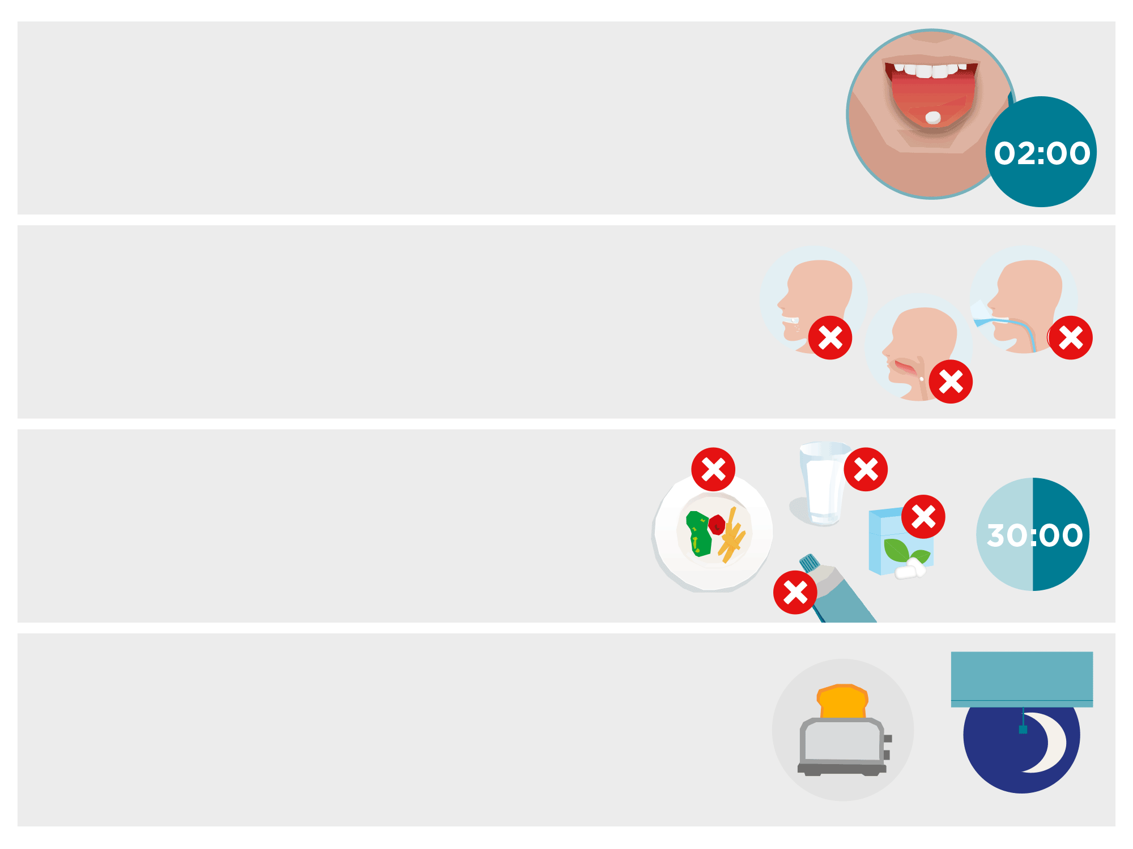

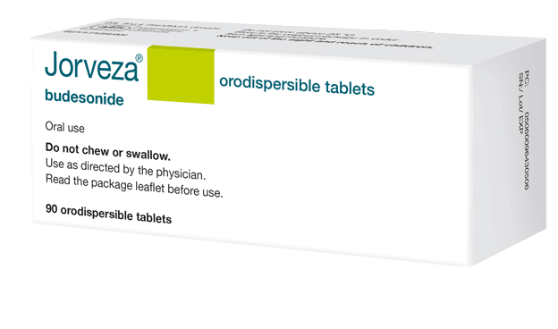
Jorveza instructions for use
Jorveza is placed on the tip of the tongue, then gently pressed against the roof of the mouth while it dissolves.
It should take about 2 minutes for the Jorveza tablet to dissolve completely.
Jorveza should not be chewed, or swallowed undissolved, or taken with liquid.
It’s very important that patients give Jorveza time
to work. So, at the very least, they should leave
30 minutes before eating, drinking, cleaning teeth
or chewing gum.
It may help if patients take Jorveza after they have had breakfast and brushed their teeth in the morning and very last thing at night, just as they go to bed. That way Jorveza will stay in contact with the oesophagus for as long as possible.
See an animation on how to take Jorveza here

Slide 17
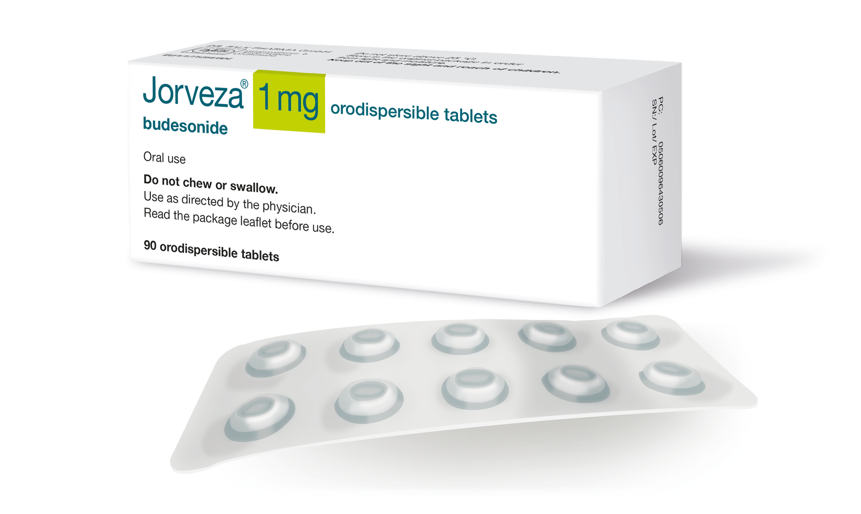
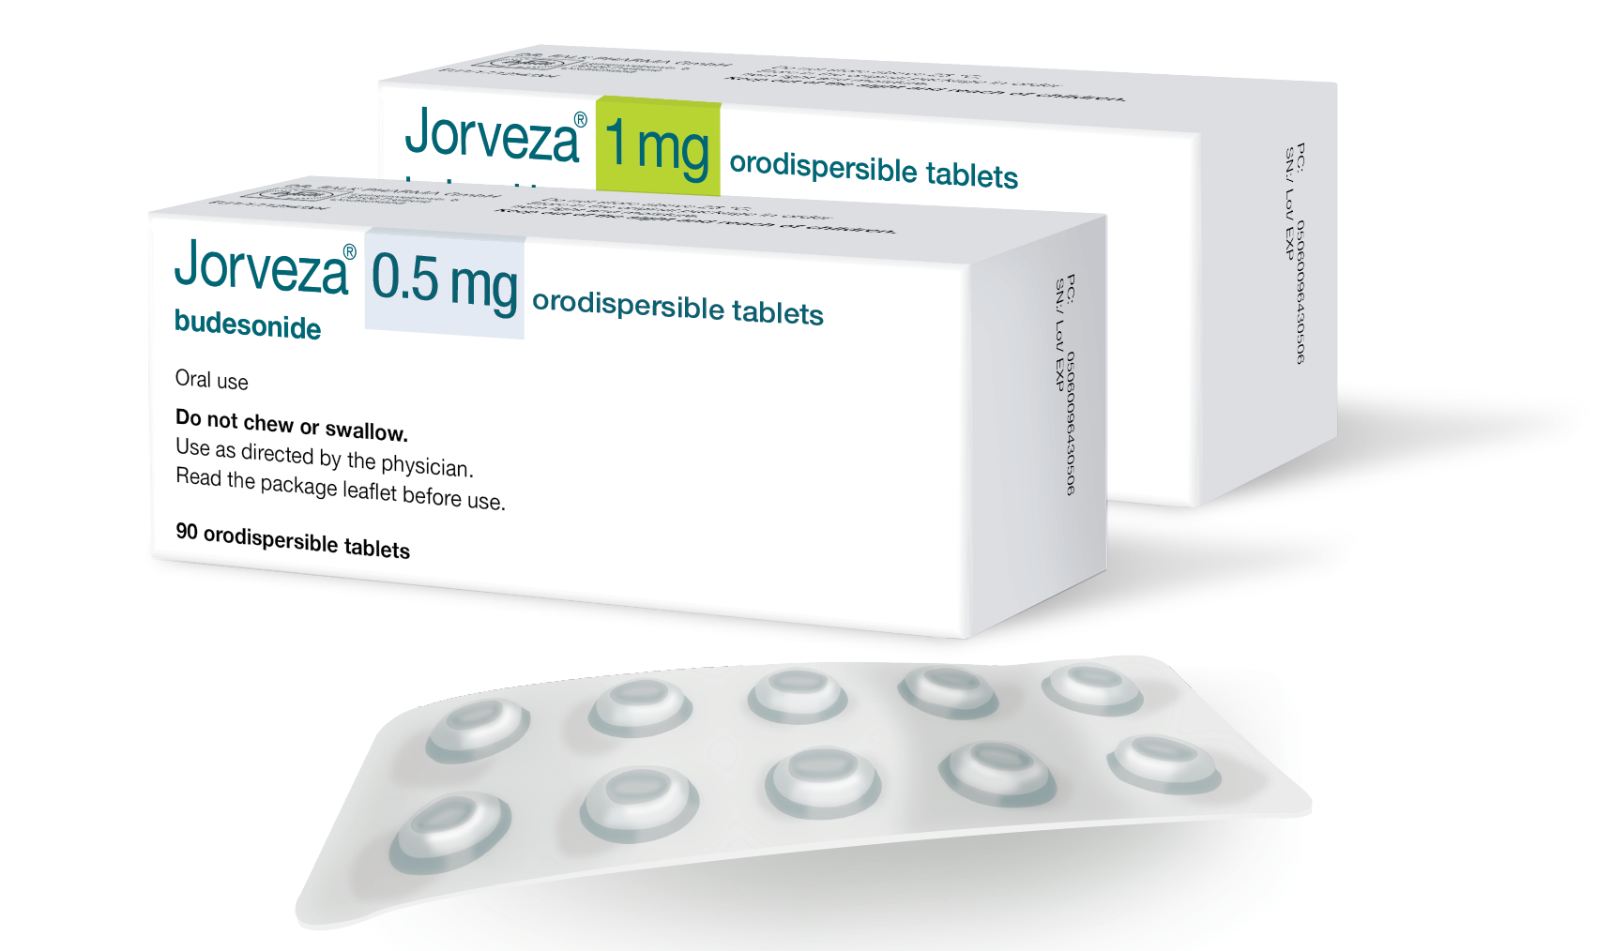
Jorveza recommended dosage
Induction of remission¹
1 mg bd
6 to 12 weeks*
*Prolongation of therapy to 12 weeks is
beneficial to bring more patients into remission²
Maintenance of remission¹
0.5 mg or 1 mg bd*
Duration determined by the treating physician
*1 mg bd is recommended for patients with
long-standing disease history and/or high
extent of oesophageal inflammation in the acute disease state
Jorveza Summary of Product Characteristics.
Lucendo AJ et al. Gastroenterology 2019; 157(1): 74-86.

Slide 18
Prescribing information
Please click on the following link for the prescribing information:
https://www.drfalk.co.uk/jorveza-1mg-oro-dipsersible-tablet/
Jorveza® (budesonide) is indicated for the treatment of eosinophilic oesophagitis (EoE) in adults (older than 18 years of age)
Adverse events should be reported. Reporting forms and information can be found at https://yellowcard.mhra.gov.uk/ (UK residents) or at https://www.hpra.ie/homepage/about-us/report-an-issue/human-adverse-reaction-form (residents of the Republic of Ireland). Adverse events should also be reported to Dr Falk Pharma UK Ltd.
www.drfalk.co.uk
Dr Falk Pharma UK Ltd, Unit K, Bourne End Business Park, Cores End Rd, Bourne End, SL8 5AS Registered in England No: 2307698
UK--2200181 Date of preparation: November 2022

