Slide 1
Eosinophilic oesophagitis
Overview for multi-disciplinary teams

Slide 2
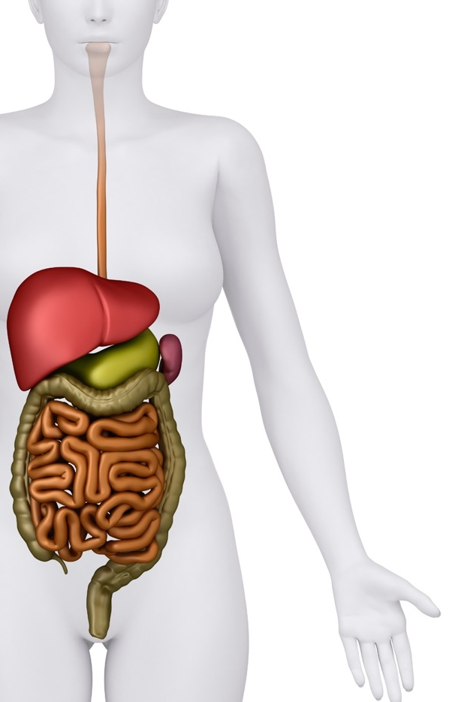
Eosinophil numbers typically increase as you go down the gut¹
Upper normal limits for eosinophil numbers within the GI tract¹
oesophagus <15/hpf
1
Eosinophils are typically present throughout the GI tract since it is continuously exposed to foods, environmental allergens, toxins, and pathogens²
2
In healthy individuals, however, the oesophagus is unique in that eosinophils are generally absent²
stomach <30/hpf
ileum <50/hpf
colon <50-100/hpf
1. Carr S, Watson W. Allergy Asthma Clin Immunol 2011; 7 (Suppl.1): S8.
2. Collins MH. Gastroenterol Clin North Am 2014; 43(2): 257-68.

Slide 3
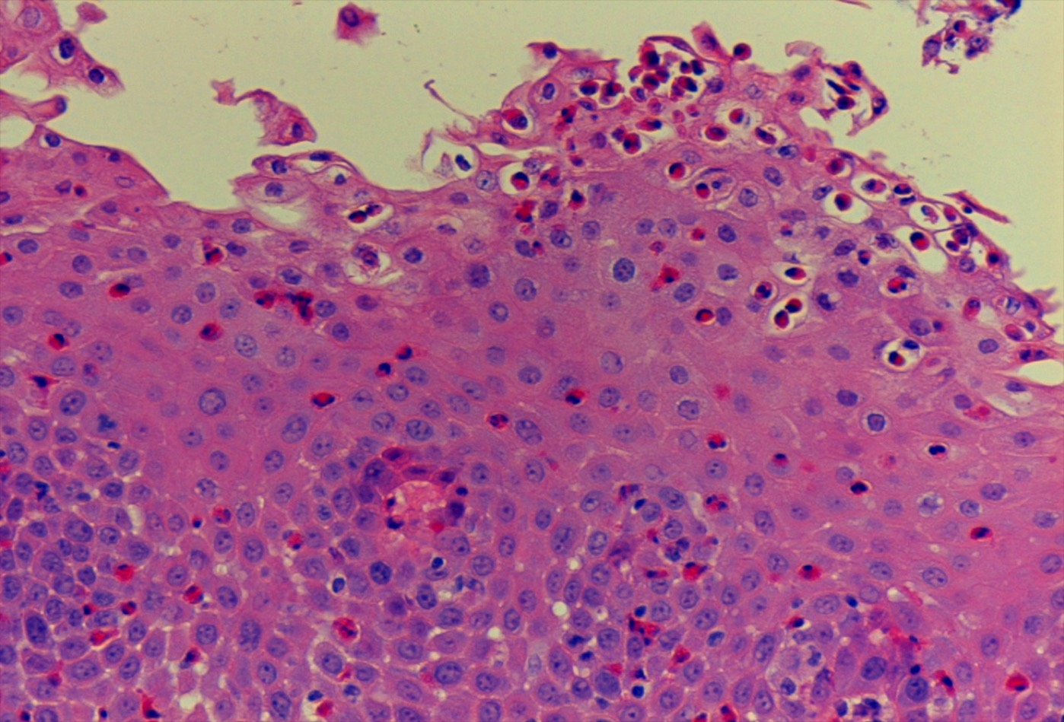
Eosinophilic oesophagitis (EoE)
EoE is a chronic disorder in which eosinophils infiltrate the oesophageal epithelium¹
It is characterised clinically by symptoms related to oesophageal dysfunction, and histologically by eosinophil-predominant inflammation¹
Since its recognition as a clinical entity in 1989,² EoE has evolved from sporadic case reports to become a widely recognised cause of oesophageal morbidity³
A European consensus group has recommended that
≥15 eosinophils per hpf as the threshold for diagnosis*¹
– because microscopes vary in regard to hpf size, this definition
is for a standard size hpf of ~0.3 mm²
1. Lucendo AJ et al. United European Gastroenterol J 2017; 5(3): 335-58.
2. Attwood SEA et al. Gut 1989; 30: A1493.
3. Chen JW, Kao JY. BMJ 2017; 359: j4482.
4. Lucendo AJ et al. Gastroenterology 2019; 157(1): 74-86.
*(48 eos/mm²)⁴
Photo: Professor Stephen Attwood

Slide 4
Eosinophilic oesophagitis comes of age
1989
1993
1994
1995
First described
as oesophageal asthma
Formally recognised as a distinct entity
Named as eosinophilic oesophagitis
Similar pathology reported in children
2007-13
2007
2004
2003-07
Focus on therapeutics increases
First diagnostic guidelines published
Incidence may exceed Crohn's disease
Research focuses on clinical phenotype
2013
2016
2018
2018
Publications rise to >200 a year
Prevalence
rising rapidly
AGREE diagnostic criteria published
Launch of the
first approved therapy

Slide 5
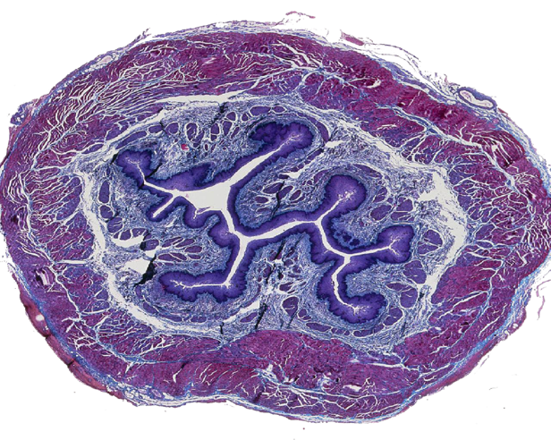
Microscopic anatomy of the oesophagus^{1,2}
Histologically the oesophagus has four layers:
The mucosa
The submucosa
The inner layer, which creates a protective barrier, it is arranged in folds that allow for expansion when food passes through
This contains glands that produce mucus, important in clearance and protecting oesophageal tissue from acid
The muscularis propria
The adventitia
The muscle layer, which pushes food down to the stomach, it is composed of an inner circular and outer longitudinal layer
The outer layer, which attaches the oesophagus to nearby parts of the body
1. Kuo B, Urma D. Esophagus – anatomy and development.
Available at: www.nature.com/gimo/contents/pt1/full/gimo6.html
2. Rice TW, Bronner MP. Thorac Surg Clin 2011; 21(2): 299-305.

Slide 6
Microscopic anatomy of the oesophagus^{1,2}
Histologically the oesophagus has four layers:
The mucosa
The submucosa
The inner layer, which creates a protective barrier, it is arranged in folds that allow for expansion when food passes through
This contains glands that produce mucus, important in clearance and protecting oesophageal tissue from acid
The muscularis propria
The adventitia
The muscle layer, which pushes food down to the stomach, it is composed of an inner circular and outer longitudinal layer
The outer layer, which attaches the oesophagus to nearby parts of the body
Fibrosis laid down
1. Kuo B, Urma D. Esophagus – anatomy and development.
Available at: www.nature.com/gimo/contents/pt1/full/gimo6.html
2. Rice TW, Bronner MP. Thorac Surg Clin 2011; 21(2): 299-305.

Slide 7
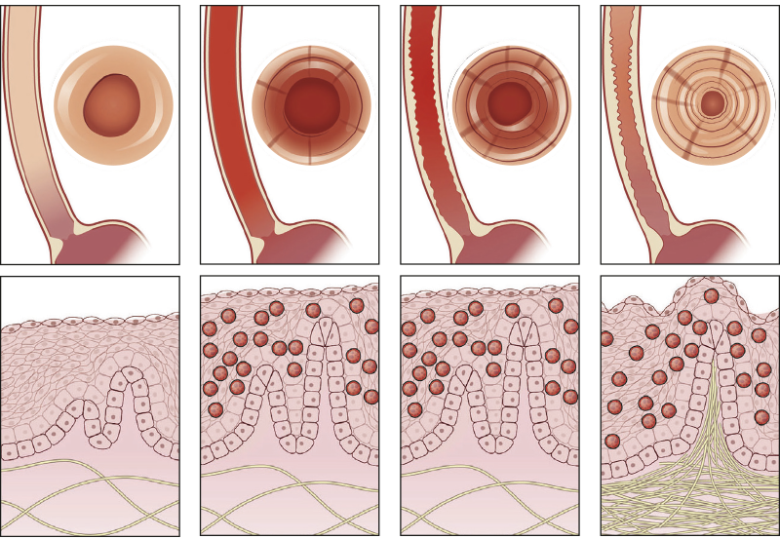
Natural history of EoE
EoE is a relatively new disease, so uncertainties remain about its natural history and long-term consequences¹
Untreated EoE is usually associated with persistent symptoms and inflammation, and it is thought that over time this leads to oesophageal remodelling resulting in stricture formation and functional abnormalities²
There is some evidence that effective
anti-inflammatory treatment may limit progression²
There is no evidence that EoE is a
pre-malignant condition²
Progression of EoE
from inflammation to fibrosis*¹
Normal
EoE
inflammation
EoE
inflammation
+ fibrosis
EoE
fibrosis
*Reprinted from Gastroenterology, vol. 154, Evan S, Dellon et al. Epidemiology and Natural History of Eosinophilic Esophagitis, 319-322. © 2018 with permission from Elsevier.
1. Dellon ES, Hirano I. Gastroenterology 2018; 154(2): 319-32.
2. Lucendo AJ et al. United Eur Gastroenterol J 2017; 5(3): 335-58.

Slide 8
Epidemiology of EoE
A recent meta-analysis of 13 population-based studies from North America,
Europe and Australia, examined the incidence and prevalence of EoE¹
EoE incidence*
EoE prevalence†
7.2
EoE can now be classed as a highly prevalent disorder, on account of the rising incidence and prevalence rates in recent years¹
28.1
cases /100,000 inhabitants
new cases /
100,000 / year
†from studies with a low risk of bias
*from post-2008 research
1. Arias Á et al. Aliment Pharmacol Ther 2016; 43(1): 3-15.
EoE: eosinophilic oesophagitis

Slide 9
Epidemiology of EoE
A recent meta-analysis of 13 population-based studies from North America,
Europe and Australia, examined the incidence and prevalence of EoE¹
EoE prevalence†
EoE incidence*
EoE can now be classed as a highly prevalent disorder, on account of the rising incidence and prevalence rates in recent years¹
7.2
28.1
New cases /
100,000 / year
cases /
100,000 inhabitants
*from post-2008 research
†from studies with a low risk of bias
1. Arias Á et al. Aliment Pharmacol Ther 2016; 43(1): 3-15.
EoE: eosinophilic oesophagitis

Slide 10
Demographic features of EoE
EoE has been reported throughout the life span, but most cases occur in children, adolescents, and adults younger than 50 years¹
While children and adults from all continents have been affected, cases are more frequently reported in white people compared with other races/ethnicities^{1,2}
Males are affected 3 to 4 times more commonly than females¹
Most patients have personal history of allergic disorders like bronchial asthma, allergic rhinitis, allergic conjunctivitis or food allergy³
– EoE is sometimes referred to as “asthma of the oesophagus”³
1. Dellon ES. Gastroenterol Clin N Am 2014: 43; 201-18.
2. Cianferoni A, Spergel J. Clin Rev Allergy Immunol 2016; 50(2): 159-74.
3. Ahmed M. World J Gastrointest Pharmacol Ther 2016; 7(2): 207-13.

Slide 11
EoE is increasingly common in North America and Europe^{1,2}
All studies examining rates of EoE over time have found that its incidence is increasing rapidly²
Rising incidence of EoE in the Netherlands³
It seems that the rapid increase is not only due to increasing recognition and awareness
of EoE²
– the relatively modest increase in rates of endoscopy with biopsy in recent years is outpaced by the increase in EoE incidence
3.0
2.0
1.0
0
Incidence (per 100,000)
Total
Male
Female
1996
2000
2005
2010
2015
Year of diagnosis
1. Arias Á et al. Aliment Pharmacol Ther 2016; 43(1): 3-15.
2. Dellon ES, Hirano I. Gastroenterology 2018; 154(2): 319-332.e3.
3. Warners M et al. Gastroenterology 2017; 152(5 Suppl. 1): S862-3.

Slide 12

The most common symptoms of EoE^{1,2}
Although differences in the pattern of presentation exist between children and adults, all of the symptoms can occur at any age¹
Younger children and infants²
Older children and adults^{2,3}
Regurgitation
Solid food dysphagia
(a sensation that food is travelling slowly down the oesophagus – this may or may not be associated
with a sensation of food sticking, usually in the chest)*
Vomiting
Abdominal pain
Food impaction
(a bolus that actually gets stuck in the oesophagus)
Food refusal
Non-swallowing/swallowing associated
chest pain
Failure to thrive
* Please note, dysphagia is a very broad medical term that means difficulty swallowing. Dysphagia can be caused by many different things; patients with EoE have a very specific type of dysphagia.
1. Attwood S. Clin Med 2013; 13(6): s32-s35.
2. Lucendo AJ et al. United Eur Gastroenterol J 2017; 5(3): 335-58.
3. Dellon ES. Available at: www.med.unc.edu/medicine/news/ chairs-corner/podcast/eoe-dellon
Accessed on 04/04/18

Slide 13
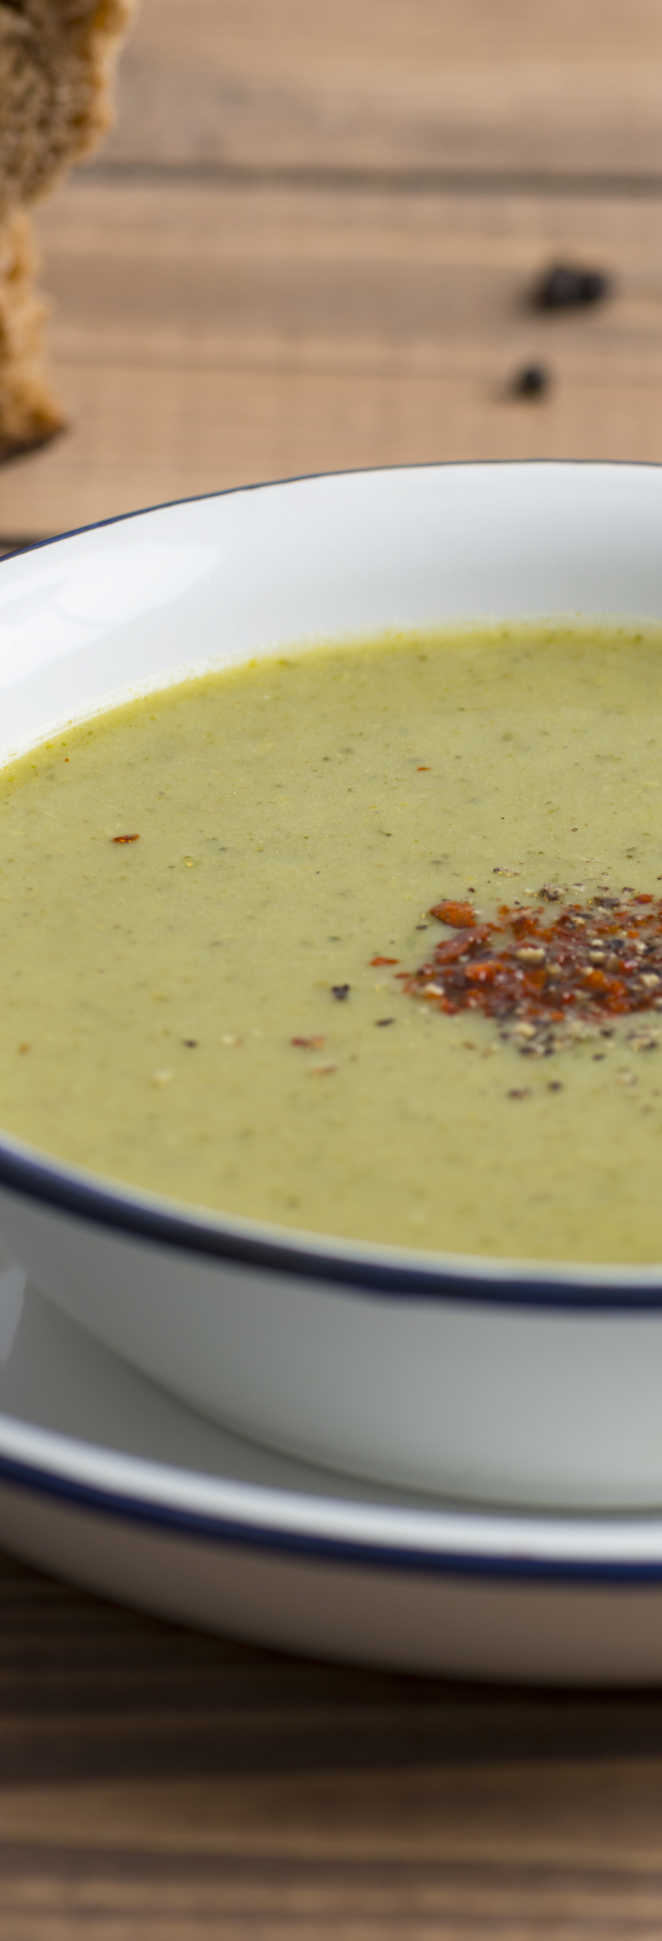
What “dysphagia” means to those with EoE
A patient with EoE typically has had the condition for many years¹
As such, they can become used to the sensation of being aware of food travelling down the oesophagus^{1,2}
They may adapt their eating in order to avoid these sensations, for example, drinking large amounts of water or only eating foods that are known to travel smoothly down the oesophagus¹
They are prolonged chewers, slow to eat and the last to finish
a meal²
1. Dellon ES. Available at: www.med.unc.edu/medicine/news/chairs-corner/podcast/eoe-dellon
Accessed on 04/04/18
2. Attwood S. Clin Med 2013; 13(6): s32-s35.

Slide 14

EoE-specific quality of life is correlated with symptoms and disease activity^{1,2}
  In a UK study, patients with EoE had reduced general energy/vitality levels – the condition also had a negative impact on their mental health¹
  – symptoms can be unpleasant, socially embarrassing and restricting^{1,3}
  – choking sensations can cause a sense of panic¹
  – ongoing or repeated courses of treatment may be required¹
  – serious complications requiring endoscopic dilatation may occur¹
  – dietary restrictions can lead to a significantly worse emotional impact³
Reducing both symptoms and disease activity are important goals for improving QoL in adult patients²
– having a diagnosis in itself can bring a sense of some relief¹
Hewett R et al. Dis Esophagus 2017; 30(1): 1-7.
Safroneeva E et al. Aliment Pharmacol Ther 2015 42(8):1000-10.
Lucendo AL et al. United European Gastroenterol J 2018; 6(1): 38-45.

Slide 15
Updated international consensus diagnostic criteria for eosinophilic oesophagitis in children and adults from the AGREE conference¹
As progress has been made in our understanding of EoE, so diagnostic guidelines have also evolved, most recently with the removal of a trial of PPI therapy as a diagnostic criterion
Clinical presentation suggestive of EoE
e.g. dysphagia, food impaction, food refusal, failure to progress with food introduction, heartburn, regurgitation, vomiting, chest pain, odynophagia, abdominal pain, malnutrition
Endoscopy with biopsies (multiple biopsies from 2 or more oesophageal levels)
Oesophageal eosinophilia ≥15 eos/hpf*²
Evaluate for non-EoE disorders that cause or potentially contribute to oesophageal eosinophilia
Eosinophilic oesophagitis
Dellon ES et al. Gastroenterology 2018; 155(4): 1022-33.
Lucendo AJ et al. Gastroenterology 2019; 157(1): 74-86.
48 eos/mm²
eos: eosinophils
hpf: high power field
PPI: proton pump inhibitor

Slide 16
“In dysphagia, biopsy the oesophagus even if it looks normal”¹
In up to 10% of adults and up to a third of paediatric cases of EoE, the oesophagus will look normal²
Because inflammatory changes are often patchy and may not be present in all biopsies,
it is recommended that at least 6 biopsies should be obtained²
Biopsies should be targeted to areas of endoscopic abnormality, mainly white exudates and longitudinal furrows, which are associated with higher peak eosinophil counts^{1,2}
Ability to correctly identify those with EoE³
100
80
60
40
20
0
~100%
“ . . . Multiple tissue samples should be obtained from the proximal, distal and intervening esophageal mucosa”⁴
Sensitivity (%)
55%
Single biopsy
Six biopsies
Attwood S. Clin Med 2013; 13(6): s32-s35.
Lucendo AJ et al. United Eur Gastroenterol J 2017; 5(3): 335-58.
Beg S et al. Gut 2017; 66(11): 1886-99.
Yantiss RK, Odze RD. Am J Gastroenterol 2009; 103(3): 774-83.

Slide 17
Differential diagnosis¹
Patient characteristics | Eosinophilic oesophagitis | GORD | Oesophageal cancer | Dysmotility
Dysphagia | Intermittent / continuous | Unusual | Progressive / continuous | Intermittent with long history
Heartburn | Less common | Characteristic | Previous history | Rare
Chest pain | Can be prominent feature | May occur | Rare | Common
Food impaction | Common | Rare | May occur rarely | Rare / occasional
Vomiting | More common in children | Rare | Rare | No
Regurgitation | Infrequent but secondary to food being stuck | Common but from stomach contents with foul taste | Infrequent but secondary to food being stuck | May occur
History of atopy | Common | No | No | No
Age | Uncommon >60 | Any age | >50 | Any age
Diagnostic tests
Endoscopy | Oesophageal rings and vertical furrows may be seen | Distal oesophagitis / distal strictures may be seen | Diagnostic of a tumour | Frequently normal
Biopsy | >15 eosinophils /hpf | < 5 eosinophils / hpf | Diagnostic | Normal
Barium swallow | May show strictures or narrow bore oesophagus | May show distal strictures | Can be diagnostic | May show dilation
24-hour pH studies | Normal | Abnormal | N/A | Usually normal
Manometry | Normal or distal obstruction | May be normal or hypomotility | Normal or obstruction | Diagnostic of dysmotility
1. Working Group. Data on file, Dr Falk.

Slide 18
Distinguishing EoE from gastro-oesophageal reflux disease (GORD)
EoE patients are frequently incorrectly labelled as having GORD¹
Although they are not mutually exclusive disorders, the ≥15 eos/hpf* threshold was chosen for its capacity to reliably distinguish between the two²
Clinical signs and symptoms that can aid the distinction of EoE from GORD³
Factors | EoE | GORD
Dominant symptom | Dysphagia | Heartburn Regurgitation
Food impaction | Common | Uncommon
Gender | Male predominance | Male = Female
Age | Children, young adults | Middle-age
Endoscopic findings | Oedema, rings, exudates furrows, strictures, crépe-paper oesophagus, narrow calibre oesophagus Normal findings on endoscopy: minority | Erosions, ulcers, Barrett’s adenocarcinoma, strictures Normal findings on endoscopy: majority
Ambulatory pH testing | Negative or positive | Positive
Histology | ≥15 eos/hpf | <7 eos/hpf
Aetiology | Immune-mediated or antigen-mediated response | Acid reflux
1. Attwood S. Clin Med 2013; 13(6): s32-s35.
Lucendo AJ et al. United Eur Gastroenterol J 2017; 5(3): 335-58.
Kia L, Hirano I. Nat Rev Gastroenterol Hepatol 2015; 12(7): 379-86.
4. Lucendo AJ et al. Gastroenterology 2019; 157(1): 74-86.
*(48 eos/mm²)⁴

Slide 19
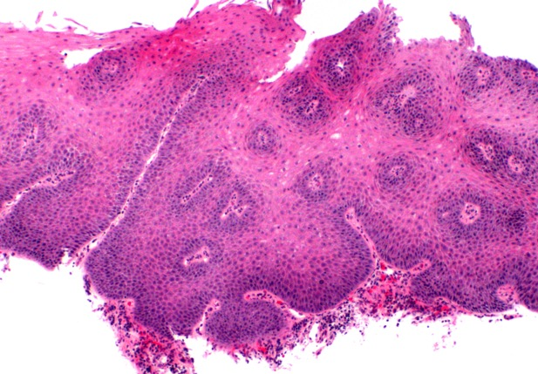
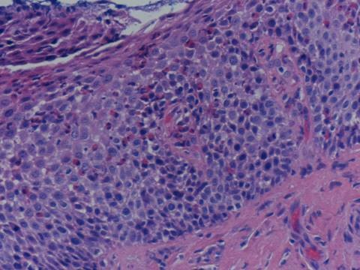
EoE and GORD have differences in their histological presentations¹
GORD¹
EoE²
>15 eosinophils / hpf
Elongation of the papillae: 90% of epithelial thickness
Papillary height: 80% of epithelial thickness
Basal zone hyperplasia:
90% of epithelial thickness
Basal cell hyperplasia:
50% of epithelial thickness
1. Fiocca R et al. Am J Gastroenterol 2010; 105(5): 1015-23.
2. Attwood SE et al. Dig Dis Sci 1993; 38(1): 109-16.
EoE: eosinophilic oesophagitis
GORD: gastro-oesophageal reflux disease
hpf: high power field

Slide 20
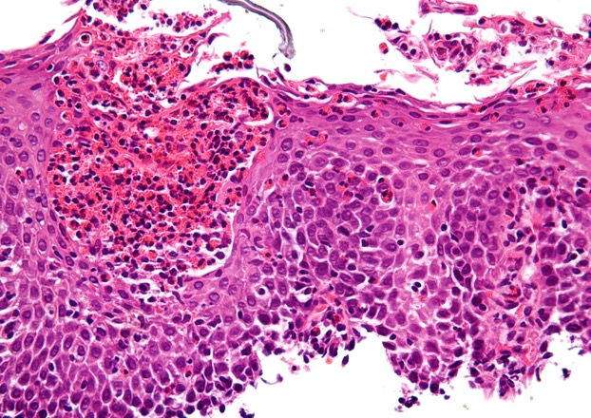
EoE has a distinctive histological presentation^{1,2}
EoE
This is a typical esophageal squamous epithelium affected
by EoE
Basal zone hyperplasia and increased papillary height with dilated intercellular spaces are seen in both GORD and EoE but the features that differentiate EoE include >15 eosinophils per hpf, eosinophil surface layering and eosinophil microabscesses
Eosinophil surface layering
Eosinophil microabscess
Dilated intracellular spaces – can also be seen in GORD
>15 eosinophils / hpf
Papillary height: 80% of epithelial thickness
Basal zone hyperplasia:
90% of epithelial thickness
1. Fiocca R et al. Am J Gastroenterol 2010; 105(5): 1015-23.
2. Wong S et al. World J Gastrointest Pathophysiol 2018; 9(3): 63-72
EoE: eosinophilic oesophagitis
GORD: gastro-oesophageal reflux disease
hpf: high power field

Slide 21

EoE and GORD have differences in their histological presentations¹
GORD
This example does not show dilated intracellular spaces, but such features do not distinguish GORD from EoE
Rare scattered intraepithelial eosinophils: <5 /hpf
Elongation of the papillae: 90% of epithelial thickness
Basal cell hyperplasia:
50% of epithelial thickness
Scattered lymphocytes
and neutrophils
1. Fiocca R et al. Am J Gastroenterol 2010; 105(5): 1015-23.
2. Wong S et al. World J Gastrointest Pathophysiol 2018; 9(3): 63-72
EoE: eosinophilic oesophagitis
GORD: gastro-oesophageal reflux disease
hpf: high power field

Slide 22
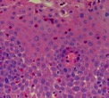
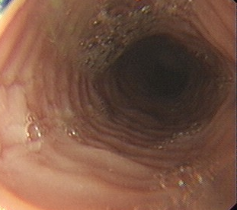
The “3D-approach” to EoE treatment: drugs, diet and dilation¹
Treatment of EoE is based on its pathogenesis¹
Dietary changes
Dilation
Target the inflammation associated with EoE
Treat oesophageal remodelling and fibrotic complications
Drugs
There is some debate about whether the aim for treatment should be symptomatic remission, histological remission, or both²
Although the most common endpoint is a reduced number of eosinophils
in biopsies, changes in symptoms and endoscopic features are becoming important targets of therapy³
1. Dellon ES, Liacouras CA. Gastroenterology 2014; 147(6): 1238-54.
2. Abe Y et al. Clin J Gastroenterol 2017; 10(2): 87-102.
3. Straumann A, Katzka DA. Gastroenterology 2018; 154(2): 346-59.

Slide 23
Treating patients with confirmed EoE¹
Consider one of the following therapeutic options*
Topical steroids
Elimination diet
PPI therapy†
Clinical and histologic
remission
Histologic remission,
with persistent symptoms
No remission
Strictures/narrow calibre oesophagus
Check the efficacy of alternative
anti-inflammatory treatments above
Yes
No
Endoscopic
dilation
Rule out other conditions unrelated
to oesophageal inflammation
Re-evaluation of the initial diagnosis
No remission
Elemental diet
Experimental drugs
Long-term treatment with an effective
anti-inflammatory drug or diet
*In patients with persistent symptoms under anti-inflammatory therapy, endoscopic dilation should be considered
†PPI therapy is not licensed for the treatment of EoE
1. Lucendo AJ et al. Expert Rev Gastroenterol Hepatol 2017; 11(12): 1135-49.

Slide 24
EoE endpoints: histology or symptoms?
Histologic measures provide “hard” outcomes^{1,2}
– may not correlate with symptoms from one patient to another
– obtaining biopsies requires repeat endoscopic procedures with associated risks and costs
Symptom control is of great importance for patients¹
– can be assessed without an invasive procedure
– may result in an underestimate of the efficacy of an intervention because patients with longstanding dysphagia may have established patterns of dietary modification to limit their swallowing difficulties
1. Dougherty T Jr et al. Gastroenterol Hepatol 2014; 10(2): 106-16.
2. Nguyen N et al. Gastroenterol Hepatol 2015; 11(10): 670-4.

Slide 25
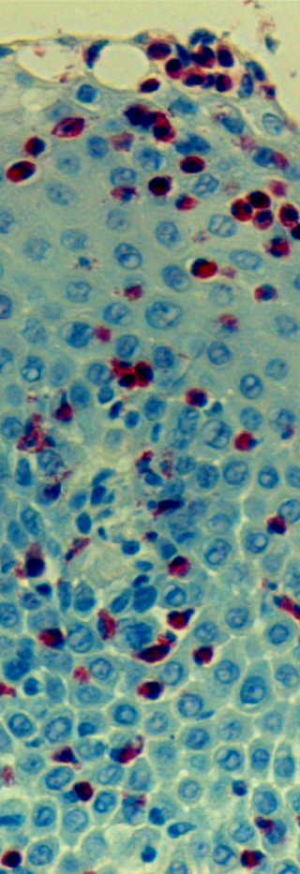
A trial of PPI therapy is no longer proposed as part of the diagnostic evaluation in suspected EoE
To establish that EoE was distinct from GORD, early investigators focused on how to exclude GORD unequivocally, and the lack of response to PPIs seemed a good way to accomplish that goal¹
However:
GORD and EoE are not mutually exclusive disorders¹
a clinical response to PPI therapy does not effectively exclude EoE
or confirm GORD²
symptomatic improvement with PPI treatment might not correlate with endoscopic and histological improvement²
a PPI trial adds expense and time to the diagnostic process (repeat endoscopy with biopsies after PPI therapy is necessary for the diagnosis of EoE)²
the appropriate duration, dose and frequency of PPI therapy have not been established²
1. Odiase E et al. Gastroenterology 2018; 154(5): 1217-21.
2. Kia L, Hirano I. Nat Rev Gastroenterol Hepatol 2015; 12(7): 379-86.

Slide 26
Drug treatment of EoE: PPIs
Please note, PPIs are not licensed for the treatment of EoE¹
PPIs decrease IL-4-stimulated eotaxin-3 expression and so may have an anti-eosinophil effect²
Since oesophageal exposure to acid causes more pain in patients with EoE than in healthy individuals, acid blockade may also reduce the symptoms of EoE³
This mechanism, along with improvement of barrier function, may be the reason why PPIs are an effective form of treatment for some EoE cases⁴
Impact of PPIs in patients with suspected EoE¹
70
60
50
40
30
20
10
0
60.8%
50.5%
(95% CI: 48.4–72.2)
Results of a recent meta-analysis of 33 studies, n=619
These results should be interpreted with caution as many of the studies were of poor quality¹
– there are no placebo-controlled trials with PPI therapy for EoE
(95% CI: 42.2–58.7)
% patients
Histological remission (<15 eos/hpf)
Symptomatic improvement
1. Lucendo AJ et al. United European Gastroenterol J 2017; 5(3): 335-58.
2. Zhang X et al. PLoS One 2012; 7(11): e50037.
3. Straumann A, Katzka DA. Gastroenterology 2018; 154(2): 346-59.
4. Durrani S, Rothenberg M. F1000Res 2017 28; 6: 1775.
CI: confidence interval
EoE: eosinophilic oesophagitis
eos: eosinophils
hpf: high power field
PPI: proton pump inhibitor

Slide 27

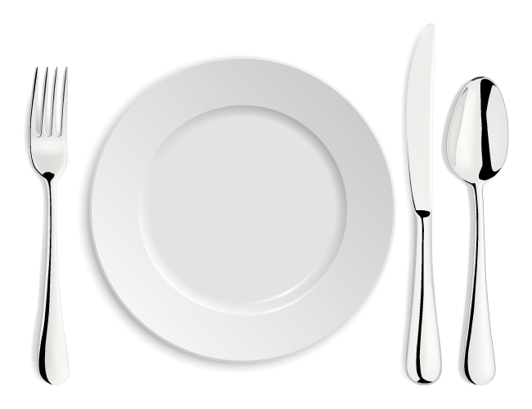
Dietary therapy for EoE
Multiple endoscopies (>7) are required to identify the causative foods^{1,2}
Patients need intensive dietetic support to prevent vitamin and nutrient deficiencies³
Significant modification of lifestyle is to the detriment of quality of life^{4,5}
The initial success
rate is only 70%¹
Few adults have the perseverance required⁶
Specialised diets causes psychosocial difficulties in children and adolescents⁷
1. Lucendo AJ et al. J Allergy Clin Immunol 2013; 131(3): 797-804.
2. Safroneeva E et al. Gastroenterology 2016; 150(3): 581-90.
3. Goyal A, Cheng E. World J Gastrointest Pharmacol Ther 2016; 7(1): 21-32.
4. Lucendo AJ et al. Aliment Pharmacol Ther 2017; 46(4): 401-9.
5. Lucendo AJ et al. United European Gastroenterol J 2018; 6(1): 38-45.
6. Gonsalves N et al. Gastroenterology 2012; 142: 1451-5.
7. Case C et al. J Pediatr Gastroenterol Nutr 2017; 65(3): 281-4.

Slide 28




Drug treatment of EoE: corticosteroids
As seen in a number of other allergic diseases, eosinophilia is relatively responsive to the administration of corticosteroids¹
Topical corticosteroids have also been shown to reduce oesophageal remodelling²
Impact of budesonide in the oesophageal mucosa on factors accompanying inflammation and lamina propria fibrosis³
Eosinophils
Mast cells
Tumour necrosis
factor-α
Epithelial
cell apoptosis
While trials have used different agents, delivery systems, and dosages, at least a partial symptomatic response is seen in about 60-75% of adults; a similar proportion achieve a complete histologic response⁴
Use of systemic steroids is not recommended because of adverse effects¹
1. Schroeder S et al. Expert Rev Clin Immunol 2010; 6(6): 929-37.
2. Straumann A, Katzka DA. Gastroenterology 2018; 154(2): 346-59.
3. Alexander JA, Katke DA. Gastroenterol Hepatol 2011; 7(1): 59-61.
4. Alexander JA. Gastroenterol Hepatol 2014; 10(5): 327-9.

Slide 29
Off-label corticosteroids are not optimised for oesophageal delivery¹
Asthma steroid preparations have been swallowed rather than inhaled to coat the oesophagus, but are suboptimal for use in EoE¹
Undesired lung deposition can result from medication administered into the mouth using metered-dose inhalers^{1,2}
While there is greater oesophageal deposition with topical viscous steroids, variable drug concentrations are possible when patients mix aqueous forms into slurries^{1,2}
Nebulised
swallowed budesonide²
Oral viscous
budesonide²
1. Dellon ES et al. Gastroenterology 2017; 152(4): 776-86.
2. Dellon ES et al. Gastroenterology 2012; 143(2): 321-4.
Reprinted from Gastroenterology, vol. 143, issue 2, Evan S. Dellon et al, Viscous Topical Is More Effective Than Nebulized Steroid Therapy for Patients With Eosinophilic Esophagitis, 321-324,
© 2012 with permission from Elsevier.

Slide 30
Off-label corticosteroids have not delivered consistent efficacy in EoE¹
Meta-analysis of placebo-controlled topical steroid RCTs in EoE: efficacy in adults¹
Histological remission
Study
Alexander 2012
Butz 2014
Straumann 2010 (not estimable)
Total
Clinical response
Study
Alexander 2012
Butz 2014
Straumann 2010 (not estimable)
Total
Odds ratio (95% CI)
Odds ratio (95% CI)
OR: 25.00
95% CI 2.64, 236.71
OR: 2.69
95% CI 0.56, 12.97
0.005
0.1
1
10
200
0.01
0.1
1
10
100
Favours placebo
Favours topical steroid
Favours placebo
Favours topical steroid
Challenges in the use of unlicensed preparations include a lack of clear instructions regarding administration, appropriate dosing and treatment duration for EoE^{1,2}
1. Murali AR et al. J Gastroenterol Hepatol 2016; 31(6): 1111-9.
2. Shah NA et al. Clin Exp Gastroenterol 2016; 9: 281-90.

Slide 31
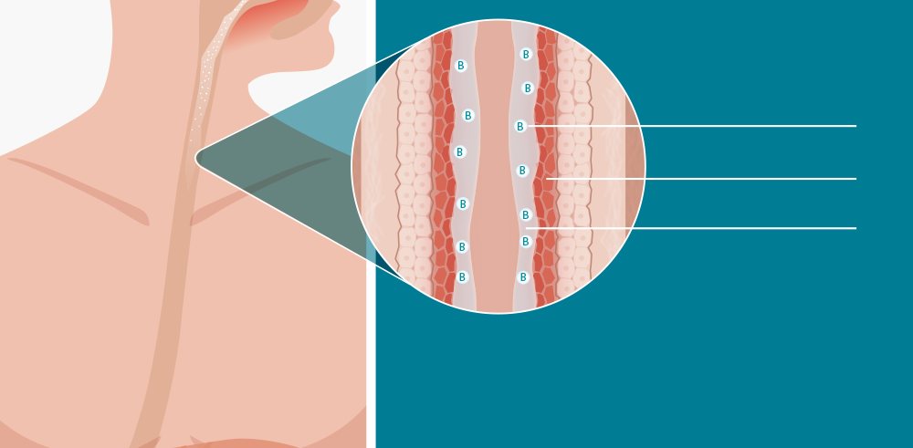
Orodispersible budesonide (Jorveza) is the first licensed medical treatment for EoE¹
Budesonide is a potent corticosteroid with a high topical anti-inflammatory activity and low systemic effects²
Jorveza is an immediate release budesonide tablet specifically designed to treat EoE³
The Jorveza tablet is placed on the tongue where it starts to effervesce, stimulating the production of saliva⁴
Budesonide
Mucosa
Saliva
As the saliva is swallowed, the mucins it contains help coat the oesophagus, effectively delivering high concentrations of budesonide to the site of inflammation^{4,5}
Jorveza Summary of Product Characteristics.
2. European Medicines Agency. Jorveza Assessment Report, November 2017.
3. Lucendo AJ et al. Gastroenterology 2019; 157(1): 74-86.
4. Data on file, Dr Falk.
5. Dodds MWJ et al. J Dentistry 2005; 33(3): 223-33.

Slide 32
Jorveza pivotal study design¹
European, multi-centre, phase lll, randomised, double-blind, placebo-controlled study
Jorveza
1mg twice-daily
n=59
n=88 patients with active EoE
R
2:1
Jorveza
1mg twice-daily
Placebo
twice-daily
n=29
6-week double-blind phase
6-week open-label extension
for non-responders
Primary endpoint
Rate of clinico-histological remission
Secondary endpoints
Rate of histological remission
Change in peak eos/mm² hpf
Rate of clinical remission (resolution of dysphagia and pain during swallowing)
Rate of clinical remission defined by EEsAI-PRO ≤20
Rate of endoscopic normalisation
Secondary endpoint
(open-label phase)
Rate of clinico-histological remission after 12 weeks active treatment
1. Lucendo AJ et al. Gastroenterology 2019; 157(1): 74-86.

Slide 33
Jorveza was highly effective at inducing remission in EoE*¹
Remission with the orodispersible budesonide tablet was achieved in over half of patients at 6 weeks¹
Prolongation of therapy to 12 weeks is beneficial to bring more patients into remission¹
6 weeks: clinical-histological remission
12 weeks: clinical-histological remission
100
80
60
40
20
0
100
80
60
40
20
0
84.7%
p<0.0001
57.6%
% patients
% patients
0%
Jorveza
Placebo
Jorveza
n=59
n=29
n=59
*Histology: <5 eos/hpf, Dysphagia: ≤2 points, Odynophagia: ≤2 points
Lucendo AJ et al. Gastroenterology 2019; 157(1): 74-86.
EoE: eosinophilic oesophagitis
eos: eosinophils
hpf: high power field

Slide 34
Jorveza: secondary efficacy endpoints
Jorveza was highly statistically superior to placebo in achieving remission/improvement in clinical, endoscopic and histological endpoints at 6 weeks¹
p<0.0001
100
80
60
40
20
0
93.2%
Changes in histology, symptoms and endoscopic features are important targets for EoE therapy²
p<0.0001
p<0.0001
59.3%
% patients
50.8%
13.8%
6.9%
Jorveza
0%
Placebo
Histological remission
Clinical remission (resolution of dysphagia)
Clinical remission
(EEsAI-PRO ≤20)
1. Lucendo AJ et al. Gastroenterology 2019; 157(1): 74-86.
2. Straumann A, Katzka DA. Gastroenterology 2018; 154(2): 346-59.
EoE: eosinophilic oesophagitis
EEsAI-PRO: EoE Activity Index Patient-Reported Outcome

Slide 35
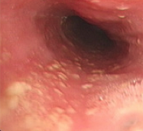
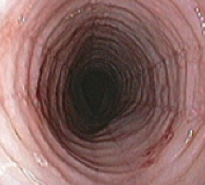
Jorveza improved both inflammatory and fibrotic signs of EoE^{1,2}
As well as the expected improvement in inflammatory signs, Jorveza improved the EEsAI fibrotic subscore¹
– this may indicate some potential to reverse the remodelling in EoE
that leads to strictures
Difference between mean EEsAI scores at week 6²
Total modified EEsAI score
Inflammatory
subscore
Fibrotic
subscore
0
-1
-2
-3
-4
-0.9
95% CI: -0.43, -1.31
-2.4
-3.3
95% CI: -1.96, -2.79
95% CI: -2.6, -3.95
Assessment of:
exudates, furrows, oedema
Assessment of:
fixed rings, stricture
1. Lucendo AJ et al. Gastroenterology 2019; 157(1): 74-86.
2. Data on file. Dr Falk.

Slide 36
Jorveza led to a quick onset of symptom resolution¹
Number of days with no or only minimal dysphagia
6
5
4
3
2
1
0
Jorveza
Days
Placebo
0
2
4
6
Jorveza patients were four times more likely to have had no or only minimal problems of dysphagia on each day in the week prior to week 6 (62.7%
vs 13.8% for placebo)
Week
Difference
between means
3.1 days
95% CI: 1.8-4.4
1. Lucendo AJ et al. Gastroenterology 2019; 157(1): 74-86.
CI: Confidence Interval

Slide 37
Orodispersible Jorveza is preferred by patients over a viscous budesonide suspension¹
Seventy-six patients with active EoE who had taken both orodispersible tablets
and a viscous suspension were asked which was their preferred budesonide formulation in a double-blind, double-dummy, randomised, placebo-controlled, multicentre trial¹
Formulation preference
100
80
60
40
20
0
80%
% patients
17%
Budesonide viscous suspension
Jorveza
1. Miehlke S et al. Gut 2016; 65(3): 390-9.

Slide 38
Jorveza (orodispersible budesonide) maintenance therapy study
DrF 20/180
Date of preparation: October 2020

Slide 39
“It is becoming clear that most, if not all, patients with EoE will need maintenance therapy to control inflammation”¹
As EoE represents a chronic disease with a high relapse rate after cessation of therapy, a long-term treatment is required³
Patients may have relapse of endoscopic and histologic features that are
not detected reliably by symptoms³
Maintenance therapy should therefore be recommended for those patients with a histologic response to topical steroids³
1. Katzka DA. Ann Intern Med 2020; 172(9): ITC65-80.
2. Straumann A et al. Gastroenterology 2020; doi: 10.1053/j.gastro.2020.07.039.
3. Dellon ES et al. Clin Gastroenterol Hepatol 2020; 18(7): 1483-92.
EoE: eosinophilic oesophagitis

Slide 40
Maintenance study design¹
European, multi­centre, phase III, randomised, double-­blind,
placebo-controlled, 48-week study
Primary outcome
Remission at week 48 with:
no clinical relapse (dysphagia or odynophagia with severity ≥4 points on at least 1 day during the
previous week)
no histological relapse (peak of
≥48 eos/mm² hpf corresponding
to ≥15 eos/hpf
no food impaction requiring endoscopic intervention
no need for dilation
no premature withdrawal for any reasons
Jorveza 1.0 mg twice daily n=68
EoE patients in confirmed clinico-histological remission
R
1:1:1
Jorveza 0.5 mg twice daily n=68
Placebo twice-daily n=68
48 weeks
Straumann A et al. Gastroenterology 2020; doi: 10.1053/j.gastro.2020.07.039.

Slide 41
Maintenance study population¹
Eligible patients were
either in confirmed clinico-histological remission at baseline, after:
achieving the goals of the Joreveza pivotal induction therapy study
or by receiving open-label induction with Jorveza
1.0 mg twice daily for
6 weeks
Patients from both entry routes showed similar demographic and disease-specific characteristics.
Disease activity at baseline of maintenance treatment
Baseline characteristics | Jorveza 1.0 mg twice daily n=68 | Jorveza 0.5 mg twice daily n=68 | Placebo twice daily n=68
Daily dysphagia (NRS 0-10, mean) | 1 | 1 | 1
Daily odynophagia (NRS 0-10, mean) | 1 | 1 | 0
Total weekly EEsAI-PRO (0-100, mean) | 16 | 16 | 16
Patient‘s Global Assessment of EoE activity (0-10, mean) | 1 | 1 | 1
Total modified EREFS (0-9, mean) | 1 | 1 | 1
Endoscopic “no signs of EoE” | 66% | 74% | 63%
Peak eos/mm² hpf (mean) | 0 | 0 | 1
Straumann A et al. Gastroenterology 2020; doi: 10.1053/j.gastro.2020.07.039.
NRS: numerical rating scale
EEsAI-PRO: Eosinophilic Oesophagitis Activity Index Patient Reported Outcome
EoE: eosinophilic oesophagitis
EREFS: Endoscopic Reference Score

Slide 42
Jorveza was highly effective at maintaining remission in EoE¹
Patients in clinic-histological remission at week 48
100
75
50
25
0
p<0.001
p<0.001
75.0%
73.5%
The efficacy of Jorveza
was generally consistent
across subgroups
% patients
4.4%
Jorveza
1.0 mg bd
n=68
Jorveza
0.5 mg bd
n=68
Placebo
n=68
Remission rates in patients with extended inflammation (all 3 segments affected
at baseline of induction therapy) were higher for Jorveza 1.0 mg than 0.5 mg
(80% vs 68% vs 3% for placebo)
Straumann A et al. Gastroenterology 2020; doi: 10.1053/j.gastro.2020.07.039
EoE: eosinophilic oesophagitis

Slide 43
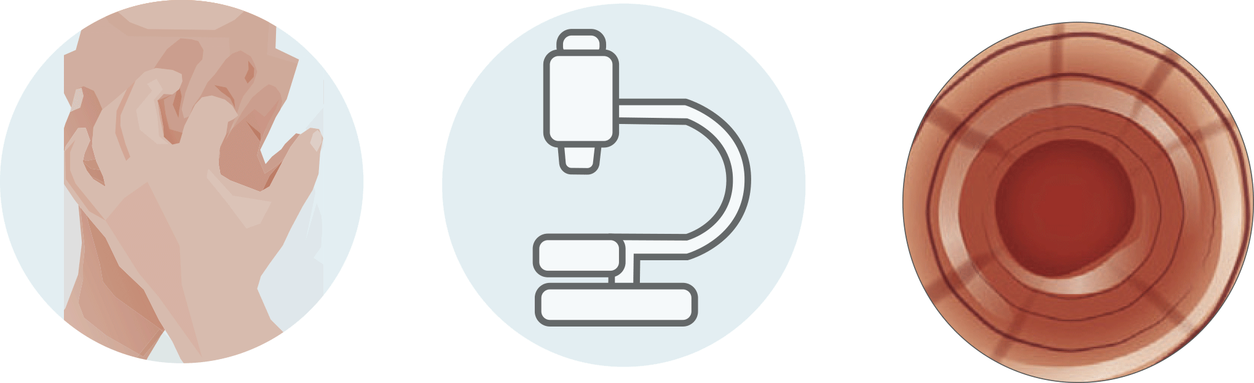
All secondary efficacy outcomes confirmed superiority of Jorveza over placebo¹
Clinical remission
(EESAI-PRO ≤20)
Deep histological
remission
(0 eos/mm² hpf)
Deep endoscopic
remission
(no signs of EoE)
p<0.001
100
75
50
25
0
p<0.001
100
75
50
25
0
p<0.001
100
75
50
25
0
p<0.001
p<0.001
79.4%
76.5%
p<0.001
73.5%
72.1%
73.5%
67.5%
% patients
% patients
% patients
20.6%
7.4%
1.5%
Jorveza 1.0 mg bd n=68 Jorveza 0.5 mg bd n=68 Placebo n=68
Straumann A et al. Gastroenterology 2020; doi: 10.1053/j.gastro.2020.07.039.

Slide 44
Half of the placebo patients had relapsed within 3 months¹
Time to clinical relapse
100
75
50
25
0
Jorveza 1.0 mg bd
n=68
Jorveza 0.5 mg bd
n=68
Placebo
n=68
% patients
These data highlight that EoE requires
a proper long-term anti-inflammatory therapy because, without active treatment, most patients relapse within
100 days after cessation of the medication
Median time to clinical relapse: 87 days
0
100
200
300
400
Days
Straumann A et al. Gastroenterology 2020; doi: 10.1053/j.gastro.2020.07.039.
EoE: eosinophilic oesophagitis

Slide 45
Jorveza can reduce the emotional and social toll of EoE long-term (EoE-QoL-A )¹
EoE-QoL-A significantly improved in all domains with Jorveza 0.5 mg and 1.0 mg twice daily, but deteriorated with placebo
Change from baseline in EoE-QoL-A 30 score at week 48
p<0.001
Bearing in mind that all patients started with an already very good QoL, the relative improvement and deterioration under Jorveza and placebo respectively are clinically relevant
10
8
6
4
2
0
-2
-4
-6
-8
-10
+9.4%
p<0.001
+6.3%
% patients
-6.7%
Jorveza
1.0 mg bd
n=68
Jorveza
0.5 mg bd
n=68
Placebo
n=68
Straumann A et al. Gastroenterology 2020; doi: 10.1053/j.gastro.2020.07.039.
EoE: eosinophilic oesophagitis
EoE-QoL-A: Eosinophilic Oesophagitis Quality of Life Scale for Adults
QoL: quality of life

Slide 46
Jorveza can reduce the emotional and social toll of EoE long-term (modSHS)¹
The modSHS is a responsive measure of subjective health that has been previously used in ulcerative colitis, collagenous colitis and Crohn’s disease patients
A significant and clinically relevant deterioration in all four QoL scales was observed in the placebo group
Increase in
symptom burden
Deterioration in
social function
Increase in
disease-related worry
Deterioration in
general well-being
p<0.0001
p<0.0001
25
20
15
10
5
0
-5
23
25
20
15
10
5
0
-5
p=0.0003
25
20
15
10
5
0
-5
-10
p<0.0001
25
20
15
10
5
0
-5
p=0.0003
p=0.0041
p=0.0007
14
12
p=0.0022
Change in score
Change in score
Change in score
Change in score
9
1
0
-1
-2
0
-1
-3
-9
Jorveza 1.0 mg bd n=68 Jorveza 0.5 mg bd n=68 Placebo n=68
Data on file, Dr Falk Pharma
EoE: eosinophilic oesophagitis
modSHS: modified Short Health Scale

Slide 47

Jorveza can stop progression in endoscopic signs
of fibrotic remodeling¹
Patients with fixed rings (% change from baseline)
+58%
From
38.2% to 30.9%
From
42.6% to 36.8%
1 in 5 patients on placebo developed new fixed rings
vs none on Jorveza maintenance therapy
-19%
-14%
From
38.2% to 60.3%
Jorveza
2 mg daily
n=68
Jorveza
1 mg daily
n=68
Placebo
n=68
Biedermann L et al. United Eur Gastroenterol J 2019; 7: 55.

Slide 48
The frequency of adverse events was similar in the Jorveza and placebo groups¹
Food impaction requiring endoscopic intervention occurred in two patients receiving placebo, but in no Jorveza patient
Morning serum levels
of cortisol were in the normal range at baseline and did not significantly change during treatment
Adverse events
Adverse events leading to
drug withdrawal
100
80
60
40
20
0
86.8%
89.7%
100
80
60
40
20
0
83.8%
61.8%
% patients
% patients
11.8%
10.3%
Jorveza 1.0 mg bd n=68 Jorveza 0.5 mg bd n=68 Placebo n=68
Straumann A et al. Gastroenterology 2020; doi: 10.1053/j.gastro.2020.07.039.

Slide 49
Local fungal infections with Candida occurred at a higher frequency with Jorveza¹
The rate of confirmed and symptomatic oesophageal candidiasis
was 5.9% and 1.5% for Jorveza 0.5 mg and 1.0 mg twice daily respectively
It was easy to treat and almost never interfered with the daily life activities
of patients
Clinically manifested candidiasis did not increase throughout the study period
Straumann A et al. Gastroenterology 2020; doi: 10.1053/j.gastro.2020.07.039.

Slide 50
Jorveza was generally well tolerated
5% of Jorveza patients presented with symptoms and histologically confirmed fungal infections¹
in all cases, symptoms were mild
Bolus impaction requiring an emergency endoscopy for retraction was observed in one patient in the placebo group²
Neither serious adverse events nor clinically relevant changes in the morning serum cortisol levels were observed in any treatment group¹
1 Lucendo AJ et al. Gastroenterology 2019; 157(1): 74-86.

Slide 51
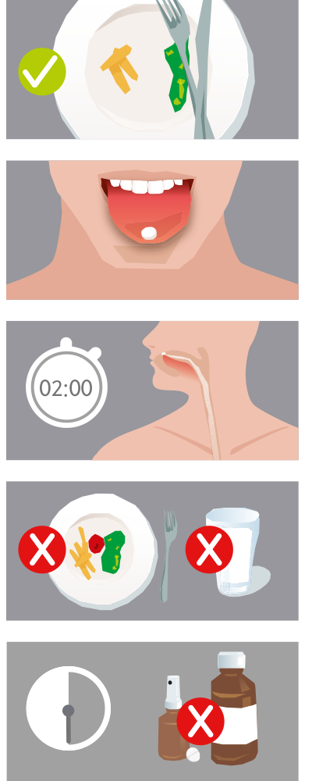
Jorveza: method of administration
Jorveza should be taken
after a meal.
Jorveza should not be taken with liquid or food. There should be at least 30 minutes before eating, drinking or teeth cleaning.
Any oral solutions, sprays or chewable tablets should be used at least
30 minutes before or after taking Jorveza.
Jorveza should be placed on the tip of the tongue and gently pressed against the roof of the mouth. The tablet should not be chewed or swallowed undissolved.
Jorveza usually dissolves within 2 minutes and should be swallowed with saliva little by little. This ensures optimal exposure of the oesophageal mucosa to the active ingredient.

Slide 52
TA7078
NICE Guidance, 23 June 2021
NICE:
Use of Jorveza for the treatment of
active EoE is cost-effective¹
Patients’ /clinical experts’ viewpoint:
- Proton pump inhibitors are not effective for most people with EoE
- Swallowing off-label corticosteroids designed for inhalation is imprecise and counterintuitive
- Dietary interventions are hugely challenging and professional support is often difficult to access
NICE committee conclusion:
There is a need for a licensed, effective treatment for EoE
active EoE is cost-effective¹
NICE guidance:
Jorveza is recommended as an option for inducing remission
of eosinophilic oesophagitis in adults
EoE: eosinophilic oesophagitis
NICE: National Institute for Health and Care Excellence
NICE TA708, June 2021. Available at: www.nice.org.uk/guidance/TA708 Accessed on: 29.06.21.
Access Prescribing Information here: https://www.drfalk.co.uk/jorveza-1mg-oro-dipsersible-tablet/
UK--2100118; Date of preparation: July 2021

Slide 53
SMC2158
SMC Advice, 12 October 2020
SMC:
The economic case for Jorveza has
been sufficiently demonstrated¹
Patient groups’ viewpoint:
EoE has an impact emotionally, socially, physically and financially
to the patient and their family/carers
Clinical experts’ viewpoint:
There is a need for a licensed, effective treatment for EoE
SMC advice:
Jorveza is accepted for use within NHS Scotland in adult
patients unsuccessfully treated with proton pump inhibitors
EoE: eosinophilic oesophagitis
SMC: Scottish Medicines Consortium
SMC2158, October 2020. Available at: scottishmedicines.org.uk/medicines-advice/budesonide-jorveza-full-smc2158/ Accessed on: 29.06.21
Access Prescribing Information here: https://www.drfalk.co.uk/jorveza-1mg-oro-dipsersible-tablet/
UK--2100118; Date of preparation: July 2021

Slide 54
Summary
Increasingly significant cause of dysphagia
Frequently misdiagnosed as GORD
Symptoms have a major impact on patients quality of life
Missed/delayed diagnosis leads to increased risk of stricture and complications
Diagnosis only through endoscopy and biopsies x6 throughout the oesophagus
Only licensed treatment for induction and maintenance in the management of EoE
  Orodispersible tablet developed to coat the oesophagus to reduce inflammation
  Simple BD dosing
  Highly effective¹
Lucendo AJ et al. United Eur Gastroenterol J 2017; 5(3): 335-58.
Notes:
Master Slides and for MDT

Slide 55
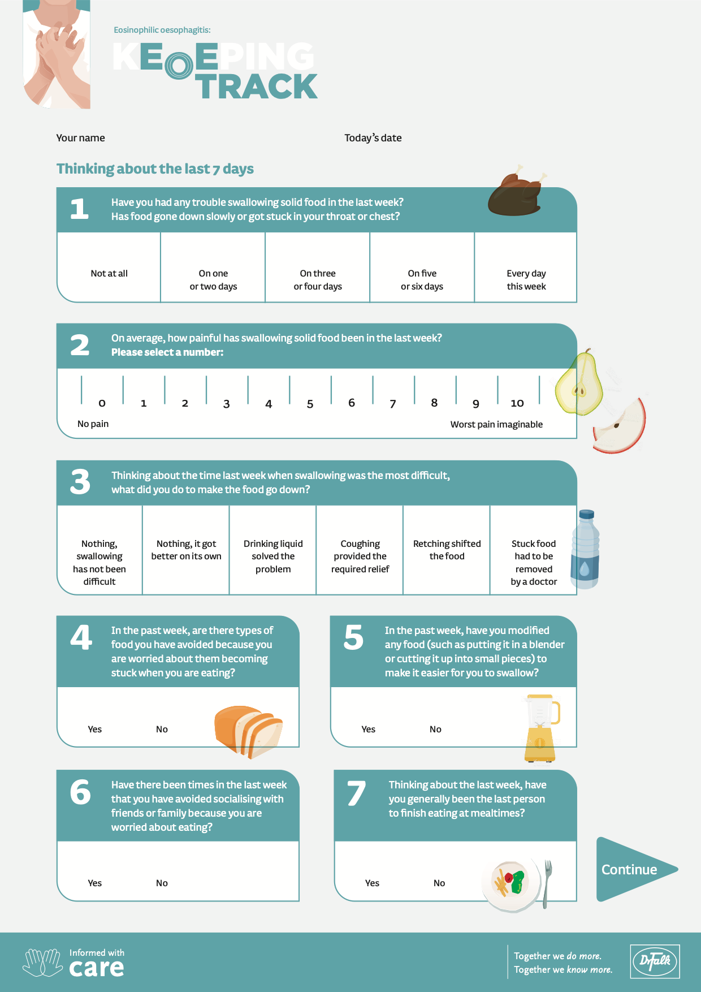

Slide 56
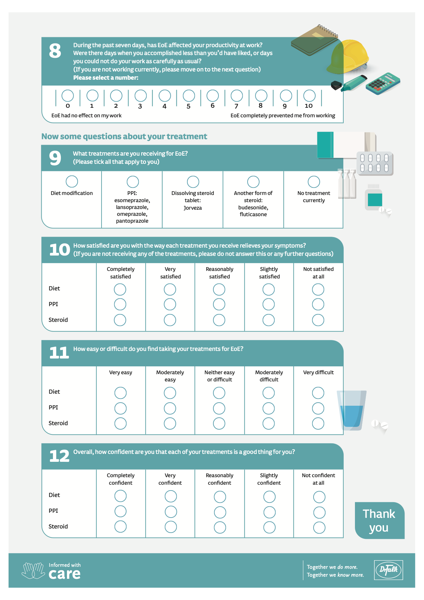

Slide 57
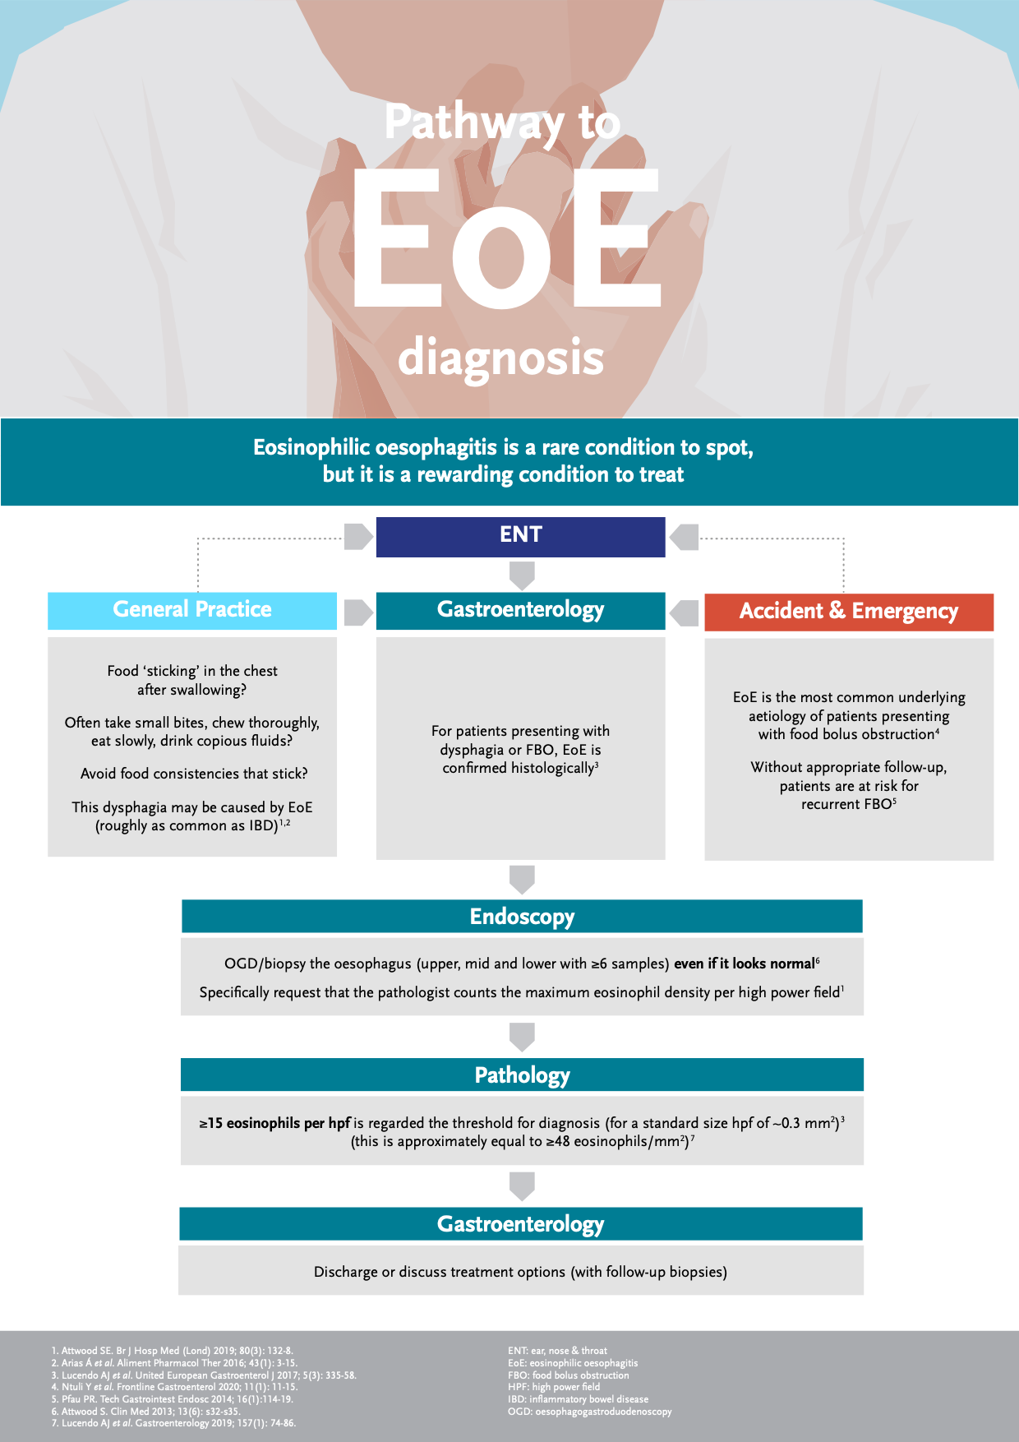

Slide 58
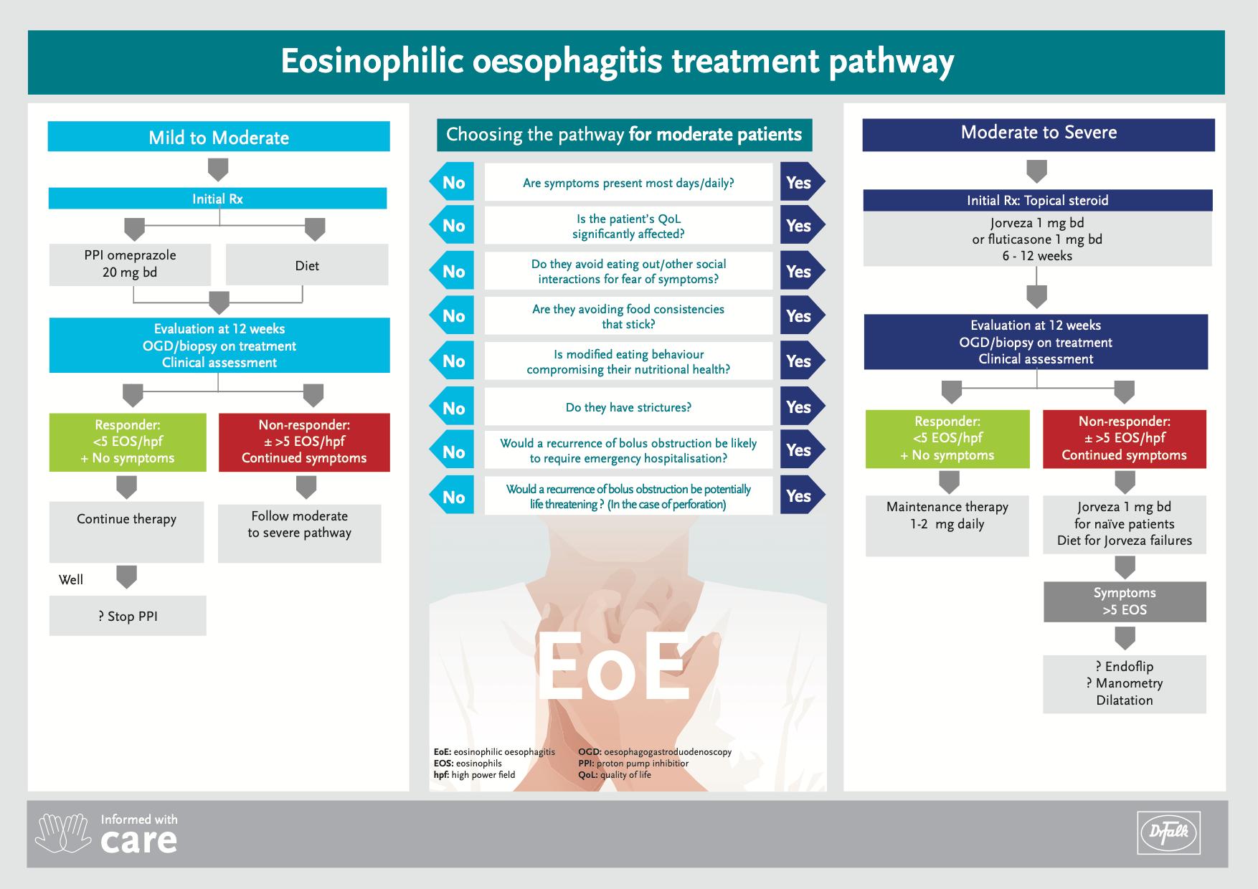

Slide 59






Considerations
European guidelines for the management of EoE are currently being updated. The treatment pathway overleaf was developed following a round table discussion of UK physicians expert in the treatment of EoE, supported by an educational grant from Dr Falk Pharma.
PPI therapy
PPI therapy is not licensed for the treatment of EoE; the appropriate duration of treatment has not been established¹
Symptomatic improvement with PPI treatment might not correlate with endoscopic and histological improvement¹
Diet therapy
A step-up empiric elimination diet is currently accepted as the initial dietary approach for EoE²
Elimination of four or more food groups should be reserved for exceptionally motivated patients, as the probable existence of three or more food triggers might make long-term restrictions unfeasible²
Patients need intensive dietetic support to prevent vitamin and nutrient deficiencies³
Steroid therapy
Off-label corticosteroids are not optimised for oesophageal delivery⁴
With topical viscous steroids, variable drug concentrations are possible when patients mix aqueous forms into slurries⁴
EoE recurs if treatment is discontinued^{5,6}
Most patients have recurrent endoscopic and histologic features that are not detected reliably by symptoms; therefore, maintenance therapy should be recommended for patients with a histologic response to topical steroids⁵
EoE: eosinophilic oesophagitis OGD: oesophagogastroduodenoscopy
EOS: eosinophils PPI: proton pump inhibitior
hpf: high power field QoL: quality of life

Slide 60
This slide is not to be presented
This deck has been provided for use in presenting about eosinophilic oesophagitis.
If you are presenting this data at a Dr Falk sponsored promotional meeting, please use the
following slide as the opening slide and keep the prescribing information slide as part of the presentation.
If you would like to incorporate additional slides, they will be subject to review by Dr Falk.
If you are presenting this slide set as part of a meeting where Dr Falk have no affiliation or role,
please delete the following two slides.
x

Slide 61
Please click on the following link for the prescribing information:
https://www.drfalk.co.uk/jorveza-1mg-oro-dipsersible-tablet/
Jorveza® (budesonide) is indicated for the treatment of eosinophilic oesophagitis (EoE) in adults (older than 18 years of age)
Adverse events should be reported. Reporting forms and information can be found at www.mhra.gov.uk/yellowcard (UK residents) or at https://www.hpra.ie/homepage/about-us/report-an-issue/human-adverse-reaction-form (residents of the Republic of Ireland). Adverse events should also be reported to Dr Falk Pharma UK Ltd.
This is a Dr Falk promotional meeting and will contain discussion of Dr Falk’s medicines
Prescribing Information is available at this meeting
UK 2100147
Date of preparation: August 2021

