Slide 1
2022 guidelines on the management of eosinophilic oesophagitis

Slide 2
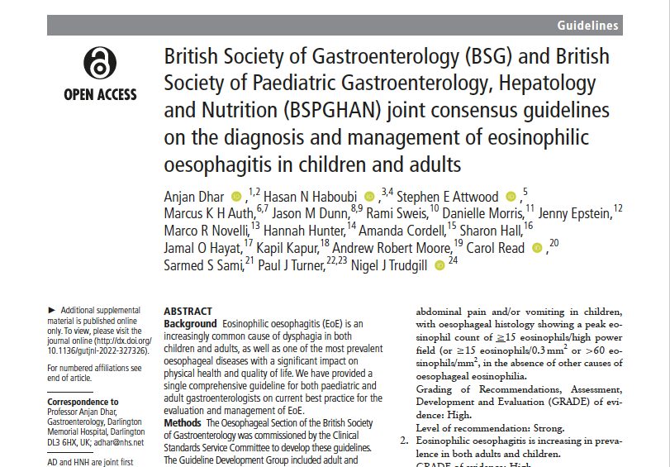
BSG / BSPGHAN consensus on the diagnosis and management of EoE in children and adults, published in Gut, May 2022¹
1. Dhar A et al. Gut 2022; 71(8): 1459-87.
BSG: British Society of Gastroenterology
BSPGHAN: British Society of Paediatric Gastroenterology, Hepatology and Nutrition
EoE: eosinophilic oesophagitis

Slide 3

Background to the guidelines¹
EoE is an increasingly common cause of dysphagia¹
Affecting ~1 in every 1500 people, the prevalence of EoE is rapidly growing²
Despite it now being one of the most prevalent oesophageal diseases, most physicians are not familiar with EoE^{1,3}
There is considerable variability in its investigation and
treatment across the UK⁴
1. Dhar A et al. Gut 2022; 71(8): 1459-87.
2. Dellon ES. Aliment Pharmacol Ther 2019; 49(11): 1448-9.
3. Pham KE. J Gastrointestinal Dig System 2019; 9(3): 598.
4. Shillitoe B et al. Frontline Gastroenterol 2021; 13(3): 231-6.
EoE: eosinophilic oesophagitis

Slide 4
EoE is an increasingly prominent topic in the published literature¹
Publications retrieved on PubMed using the search term
“eosinophilic esophagitis”²
400
300
The guidelines group considered the body of literature in EoE in providing their practical and evidence-based guide to its definition, diagnosis, and treatment³
200
100
0
1976
2021
1. Murray FR et al. Am J Gastroenterol 2022; doi: 10.14309/ajg.0000000000001950
2. PubMed. Available at: pubmed.ncbi.nlm.nih.gov Accessed on: 16.09.22
3. Dhar A et al. Gut 2022; 71(8): 1459-87.
EoE: eosinophilic oesophagitis

Slide 5
The guideline development group included representatives of relevant professional groups¹
Adult and paediatric gastroenterologists
Gastrointestinal surgeons
Dietitians
Allergists
Patient representatives
Patient support groups
Gastrointestinal physiologists
1. Dhar A et al. Gut 2022; 71(8): 1459-87.

Slide 6
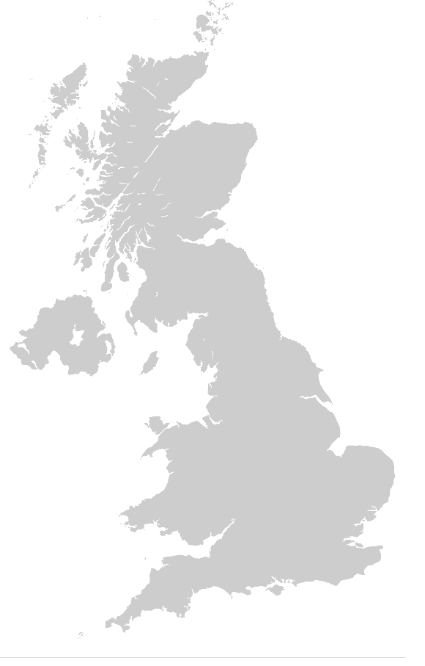
Stated aims of the BSG / BSPGHAN 2022 EoE guidelines¹
To introduce new diagnostic criteria for incorporating digital pathology and promote consistency in pathology reporting of oesophageal biopsies
To review and standardise the diagnosis, treatment and follow-up of patients with special relevance
to the National Health Service in the UK
To summarise the optimal management of both children and adults with EoE, to highlight gaps in knowledge and to set out future research priorities
1. Dhar A et al. Gut 2022; 71(8): 1459-87.
BSG: British Society of Gastroenterology
BSPGHAN: British Society of Paediatric Gastroenterology, Hepatology and Nutrition
EoE: eosinophilic oesophagitis

Slide 7
Definition of EoE¹
EoE is an oesophageal disease characterised by symptoms related to oesophageal dysfunction and eosinophil predominant mucosal inflammation
Since most laboratories are moving to
digital optical microscopy, the definition
of EoE has been expanded in the
current guidelines
1. Dhar A et al. Gut 2022; 71(8): 1459-87.
EoE: eosinophilic oesophagitis
eos: eosinophils
hpf: high-power field

Slide 8
Diagnosis¹
Emergency presentation
with food bolus obstruction
Elective setting
with symptoms suggestive of EoE
Endoscopy
Histology
≥15 eos/0.3 mm²
<15 eos/0.3 mm²
Diagnosis: EoE
Consider alternative pathology
(eg: achalasia, GORD)
No
Yes
Consider partially treated
EoE (PPI/diet?)
Treat as appropriate
Withdraw PPI for ≥3 weeks
and repeat endoscopy
1. Dhar A et al. Gut 2022; 71(8): 1459-87.
EoE: eosinophilic oesophagitis
eos: eosinophils
GORD: gastro-oesophageal reflux disease
PPI: proton pump inhibitor

Slide 9
Clinical presentation¹
Elective setting
In adults, dysphagia is strongly associated with a diagnosis
of eosinophilic oesophagitis
Symptoms suggestive of EoE
Does the patient have a feeling of food sticking in the chest after swallowing?
Do they modify how they eat, for example, drinking a lot of fluid to wash food down?
Are they often the last to finish at mealtimes, chewing their food very thoroughly?
Do they avoid eating certain foods, worried that they may get stuck completely?
Have they had self-resolving food bolus obstructions?
1. Dhar A et al. Gut 2022; 71(8): 1459-87.
EoE: eosinophilic oesophagitis

Slide 10
Confirmation of diagnosis¹
While symptoms point to EoE, it can only be confirmed histologically
Refer patients for a diagnostic OGD
≥6 biopsies should be taken from different anatomical
sites in the oesophagus
EoE is diagnosed if the peak eosinophil count
is ≥15 /0.3 mm²
For an accurate diagnosis, PPIs should be withdrawn
for ≥3 weeks prior to biopsy
Dhar A et al. Gut 2022; 71(8): 1459-87.
EoE: eosinophilic oesophagitis
eos: eosinophils
hpf: high-power field
OGD: oesophogogastroduodenoscopy
PPI: proton pump inhibitor

Slide 11
Clinical presentation¹
Emergency setting
In adults, food bolus obstruction is strongly associated
with a diagnosis of eosinophilic oesophagitis
Strongly consider EoE in all adult patients with an FBO
Make an urgent referral to gastroenterology for a therapeutic OGD
Take ≥6 biopsies at two levels at the index endoscopy
Book the patient for an endoscopy/outpatient
review if the FBO resolves spontaneously
1. Dhar A et al. Gut 2022; 71(8): 1459-87.
EoE: eosinophilic oesophagitis
FBO: food bolus obstruction
OGD: oesophogogastroduodenoscopy

Slide 12
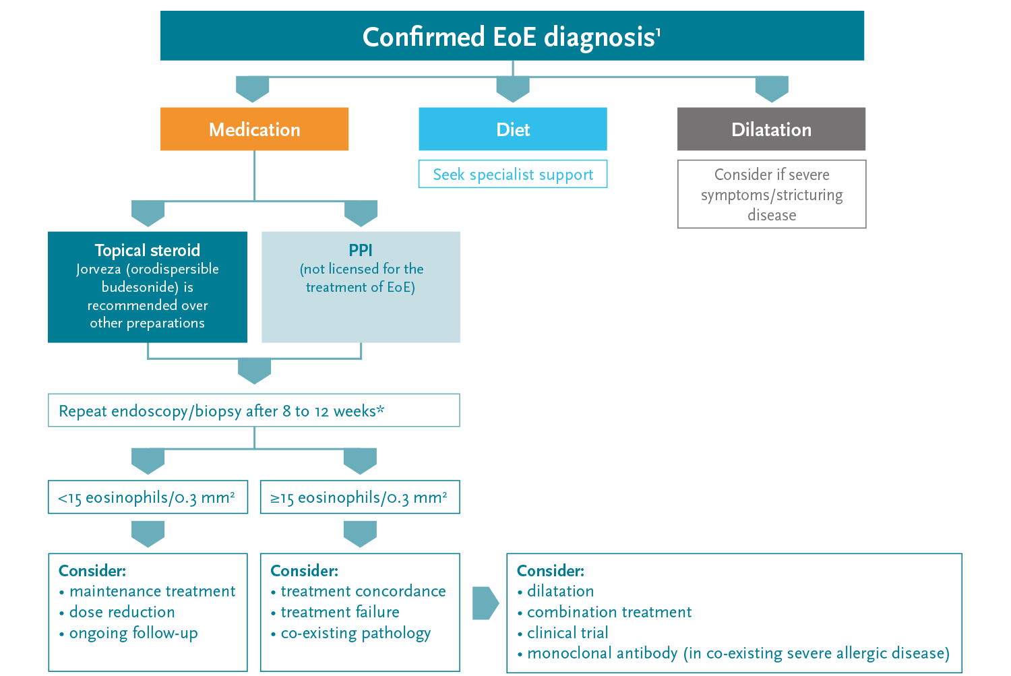
Management¹
*
*Data from a phase III induction study suggest prolongation of Jorveza therapy to 12 weeks is beneficial to bring more patients into clinico-histologic remission²
Dhar A et al. Gut 2022; 71(8): 1459-87.
Lucendo AJ et al. Gastroenterology 2019; 157: 74-86.
Prescribing information for Jorveza (orodispersible budesonide) is available via the link on the final slide
EoE: eosinophilic oesophagitis
PPI: proton pump inhibitor

Slide 13

The new BSG guidelines recommend maintenance therapy for EoE¹
Clinical and histological relapse is high after
withdrawal of topical steroid treatment and,
following clinical review, maintenance treatment should be recommended¹
Grade of evidence: Moderate
Level of recommendation: Strong
The BSG recommend Jorveza (orodispersible budesonide) – the only medicine with European regulatory approval for EoE – over other steroid formulations for both the induction and maintenance of remission in adults¹
Dhar A et al. Gut 2022; 71(8): 1459-87.
BSG: British Society of Gastroenterology
EoE: eosinophilic oesophagitis

Slide 14
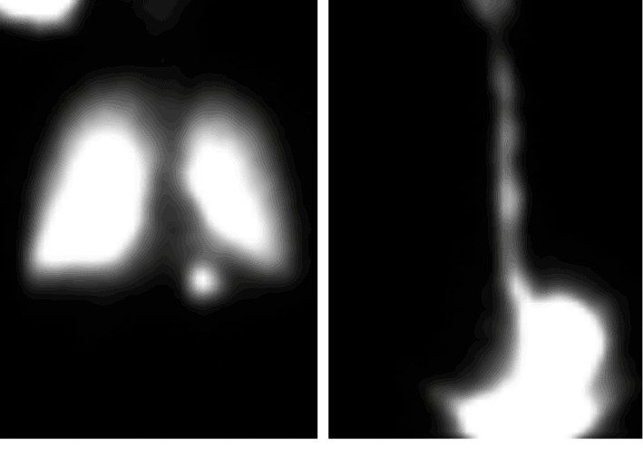
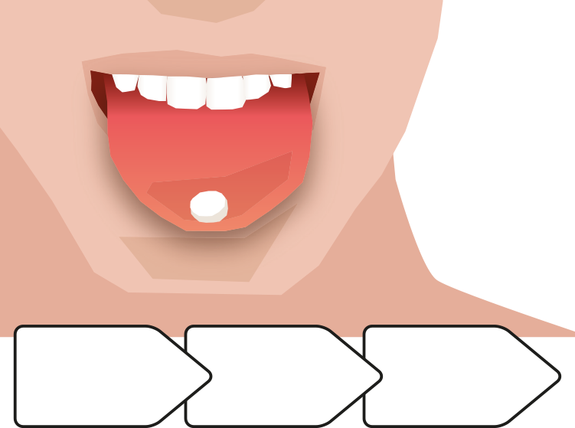
The most effective specific therapy for EoE is topical steroid treatment¹
Topical steroids are, however, only as effective as their ability to effectively uniformly coat the oesophageal mucosa²
Off-label formulations do not provide a standardised way of getting topical steroids
to the surface of the oesophagus^{3,4}
Jorveza is the only topical steroid specifically designed to target the oesophagus in patients with EoE⁵
Orodispersible tablet
Stimulates
saliva
Coats the oesophagus
Nebulised
and swallowed steroid
Oral steroid slurry
Delivers budesonide to the site of inflammation
Reprinted from Gastroenterology, vol. 143, issue 2, Evan S. Dellon et al, Viscous Topical Is More Effective Than Nebulized Steroid Therapy for Patients With Eosinophilic Esophagitis, 321-324,
© 2012 with permission from Elsevier.
1. Attwood S, Epstein J. Frontline Gastroenterol 2020; 12(7): 1644-9.
2. Katzka DA et al. Gastroenterology 2020; 159(3): 813-15.
3. Dellon ES et al. Gastroenterology 2017; 152(4): 776-86.
4. Dellon ES et al. Gastroenterology 2012; 143(2): 321-4.
5. Miehlke S et al. Therap Adv Gastroenterol 2020; 13: 1756284820927282.
EoE: eosinophilic oesophagitis

Slide 15
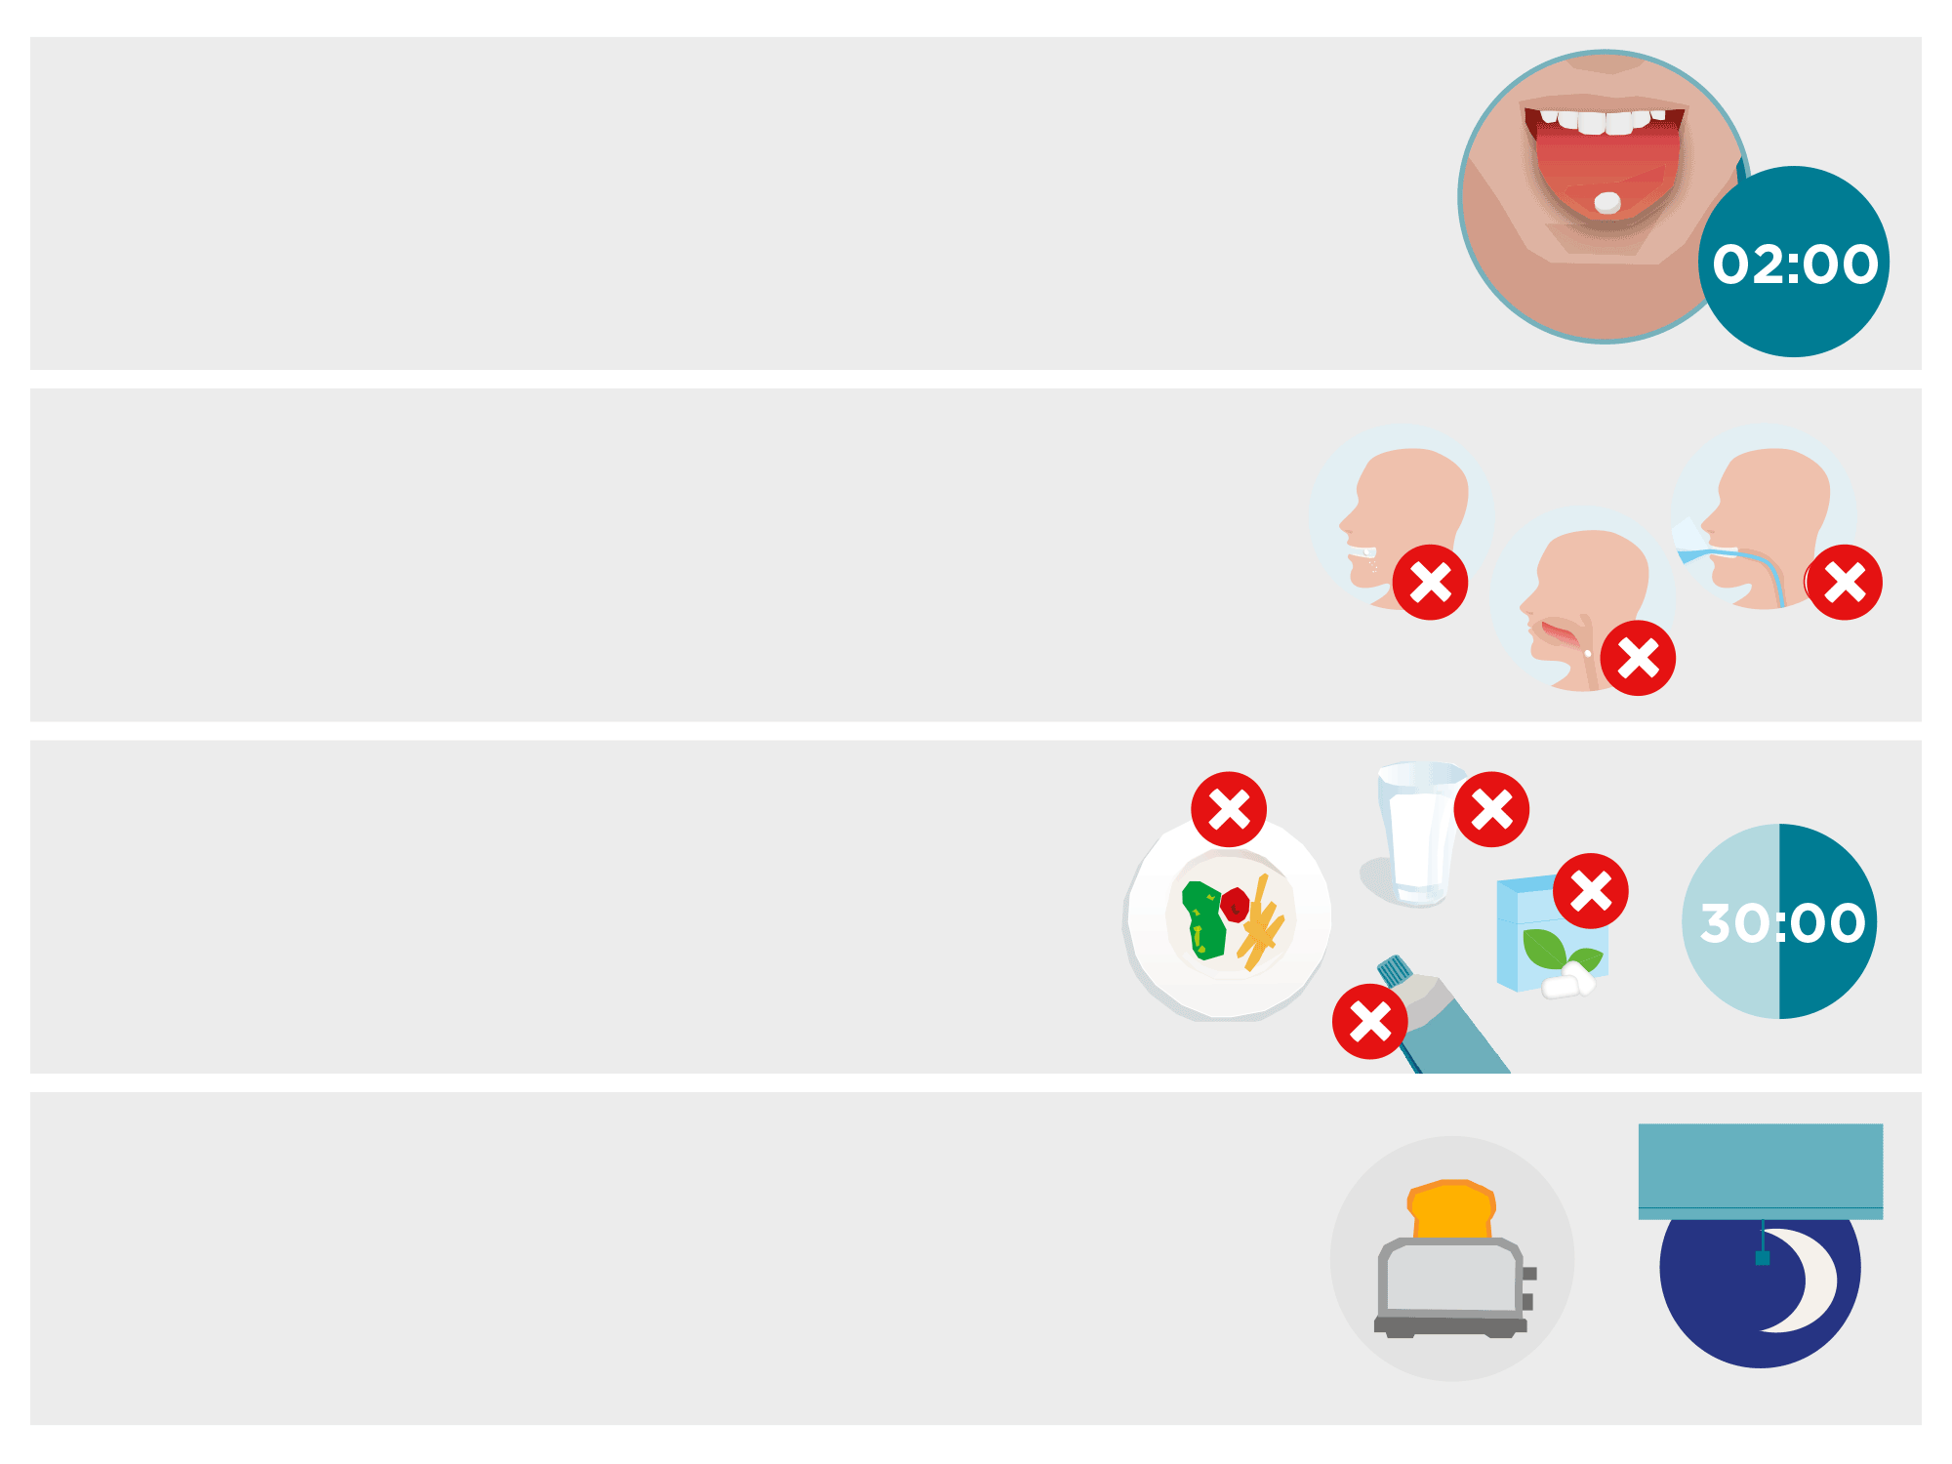
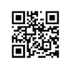
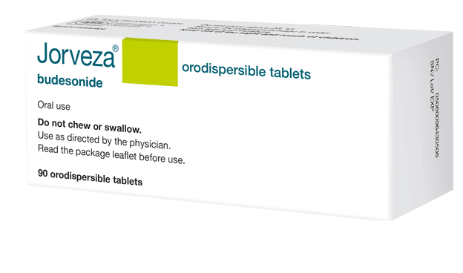
Jorveza instructions for use
Jorveza is placed on the tip of the tongue, then gently pressed against the roof of the mouth while it dissolves.
It should take about 2 minutes for the Jorveza tablet to dissolve completely.
Jorveza should not be chewed, or swallowed undissolved, or taken with liquid.
It’s very important that patients give Jorveza time
to work. So, at the very least, they should leave
30 minutes before eating, drinking, cleaning teeth
or chewing gum.
It may help if patients take Jorveza after they have had breakfast and brushed their teeth in the morning and very last thing at night, just as they go to bed. That way Jorveza will stay in contact with the oesophagus for as long as possible.
See an animation on how to take Jorveza here

Slide 16
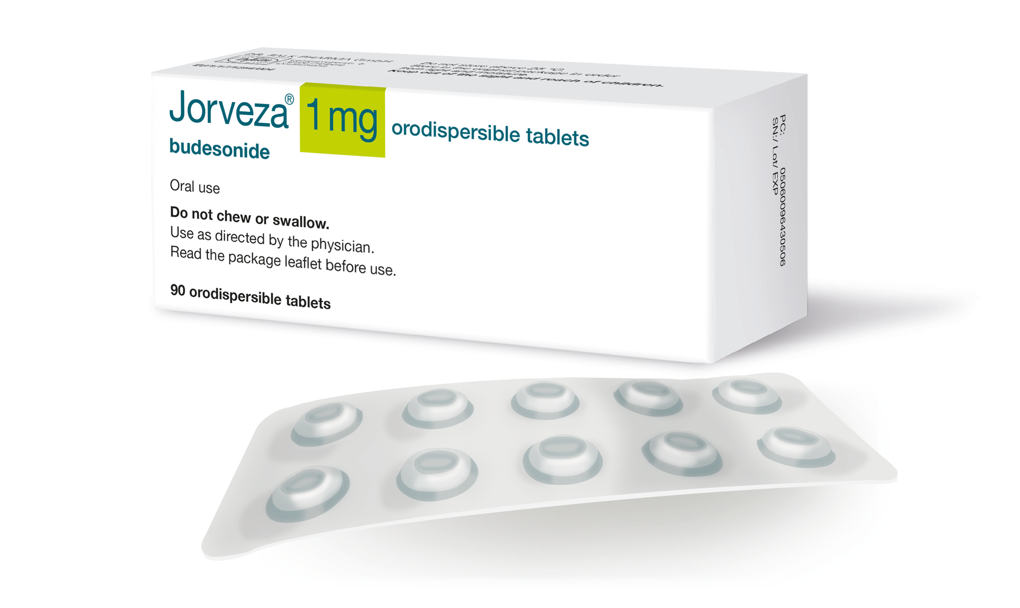
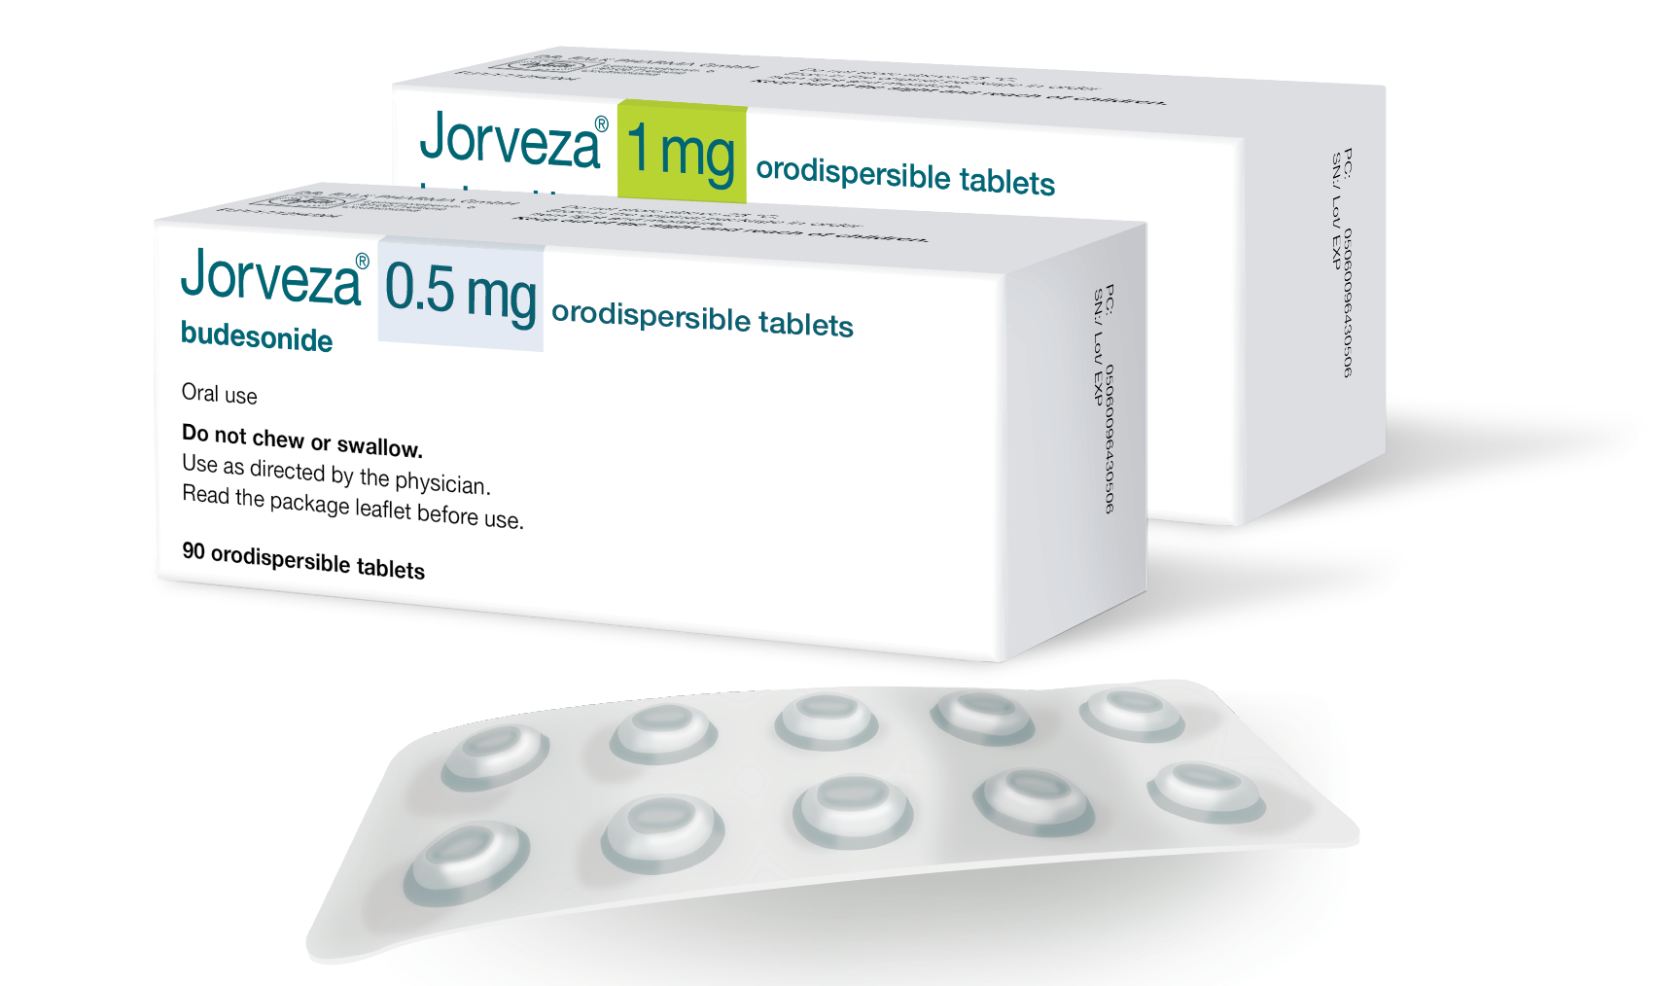
Jorveza recommended dosage
Induction of remission¹
1 mg bd
6 to 12 weeks*
*Prolongation of therapy to 12 weeks is
beneficial to bring more patients into remission²
Maintenance of remission¹
0.5 mg or 1 mg bd*
Duration determined by the treating physician
*1 mg bd is recommended for patients with
long-standing disease history and/or high
extent of oesophageal inflammation in the acute disease state
Jorveza Summary of Product Characteristics.
Lucendo AJ et al. Gastroenterology 2019; 157(1): 74-86.

Slide 17
Prescribing information
Please click on the following link for the prescribing information:
https://www.drfalk.co.uk/jorveza-1mg-oro-dipsersible-tablet/
Jorveza® (budesonide) is indicated for the treatment of eosinophilic oesophagitis (EoE) in adults (older than 18 years of age)
Adverse events should be reported. Reporting forms and information can be found at https://yellowcard.mhra.gov.uk/ (UK residents) or at https://www.hpra.ie/homepage/about-us/report-an-issue/human-adverse-reaction-form (residents of the Republic of Ireland). Adverse events should also be reported to Dr Falk Pharma UK Ltd.
www.drfalk.co.uk
Dr Falk Pharma UK Ltd, Unit K, Bourne End Business Park, Cores End Rd, Bourne End, SL8 5AS Registered in England No: 2307698
UK--2200166 Date of preparation: October 2022

